Slide 1

Semantic Graph Representation Learning in Attributed Networks
Meng Qin(覃孟)¹, Kai Lei^{1,*}
(mengqin_az@foxmail.com)
¹ ICNLAB, SECE, Peking University Shenzhen Graduate School
2019-8-11 (Sun.)

Slide 2
Outline
Graph Representation Learning
in attributed networks
Motivation
Problem Definition
Methodology
Experimental Evaluation
Conclusion
joint opt. of net. structure & semantic
Transform!
Network Embedding with Heterogeneous Entities
Nonlinear high-order feat. among structure & semantic
support advanced semantic-oriented net. inferences
(e.g., Semantic Community Detection)

Slide 3
Motivation

Slide 4
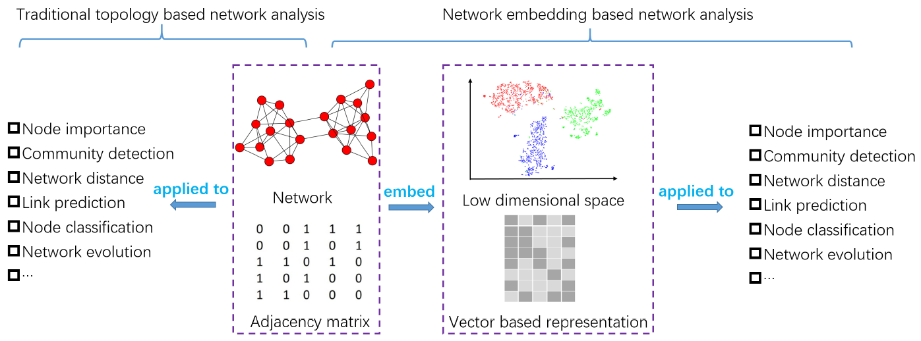
Motivation
Graph representation learning / Network Embedding (NE)
  A significant topic in the research of network analysis
  Powerful to support the downstream net. inference tasks
    e.g., community detection, link prediction, etc.
  Encode the network into a low-dim. vector representation
  With the primary properties preserved
  [Peng C., et al. 2018]

Slide 5
Motivation (Cont)
Existing NE techniques
  Categorized according to the information sources they utilize
Network Structure (Topology)
  Primary information source available for NE
  High-Order Node Proximity (e.g., LINE, DeepWalk, node2vec, GraRep, etc.)
  Community Structure (e.g., M-NMF, DNR, etc.)
Network Semantic (Attribute/Content)
  carries orthogonal & complementary knowledge beyond topology
  potentially enhance the learned representations
  Node Attribute (e.g., TADW, AANE, SNE, CANE, etc.)

Slide 6
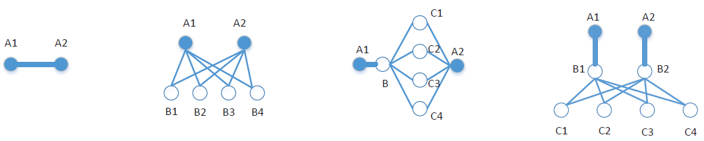
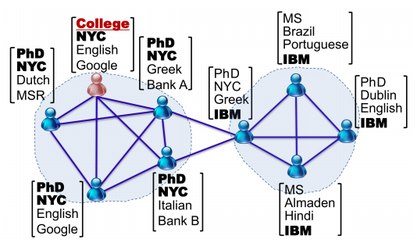
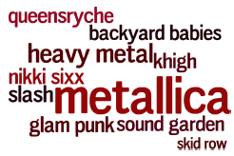

Motivation (Cont)
Limitations of existing NE techniques
  Only explore non-linear high-order feat. of Net. Topo.
  With Net. Attribute as the auxiliary regularization
  Inherently ignore the Non-Linear High-Order Feat.
  Among Net. Structure & Semantic?!
  Only Use attribute info. to improve the learned embeddings
  Cannot be directly applied to some advanced semantic-oriented tasks
  e.g., Semantic Community Detection
  community membership & semantic descriptions
  [Xiao W. et al. 2016]
[Shaosheng C. et al. 2011] (k=1,2,3,4)

Slide 7
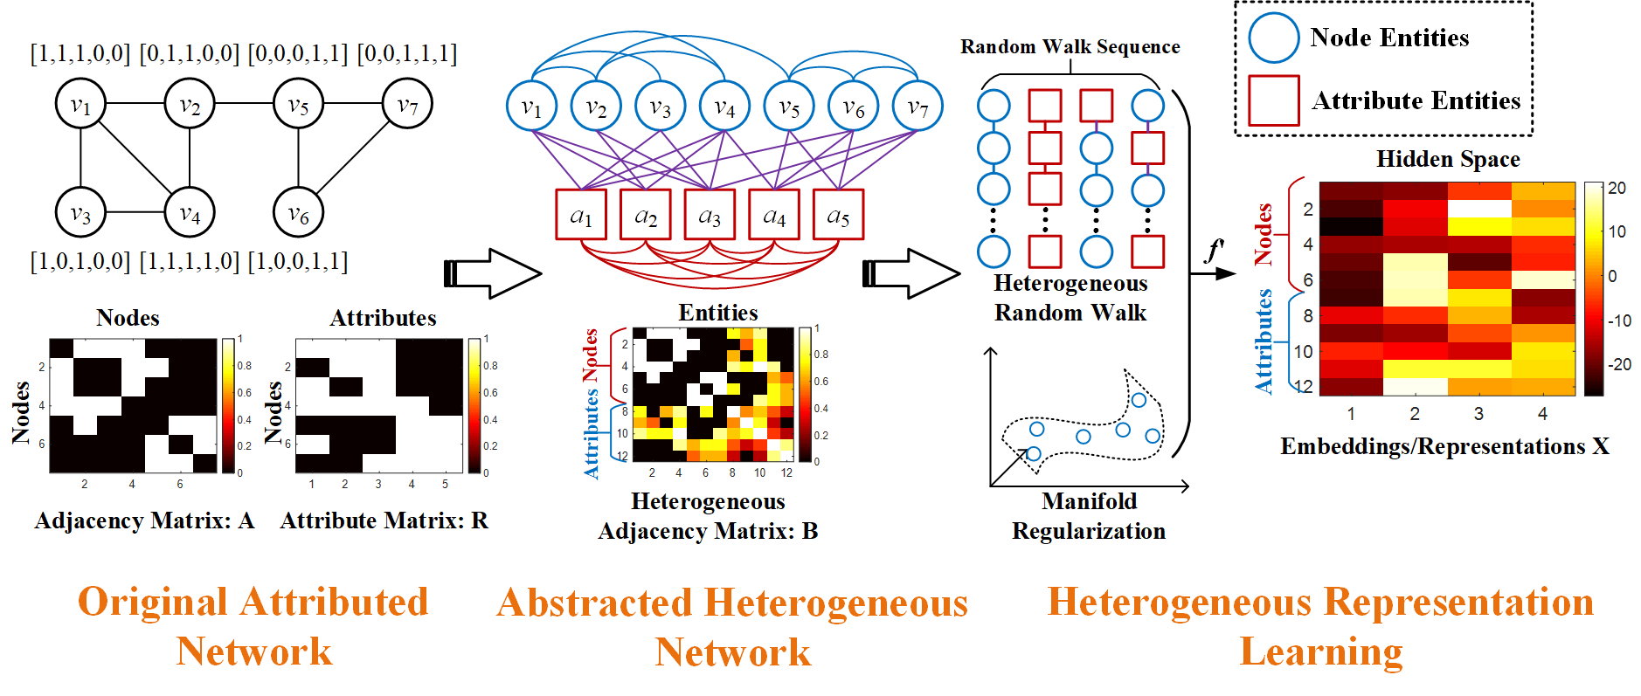
Motivation (Cont)
Semantic Graph Representation (SGR)
  Reformulate attributed network into an abstracted weighted graph
  With heterogeneous entities
  Simultaneously learn the embeddings of node and attribute (keyword)
  Deal with semantic-oriented downstream tasks
  Introduce an enhancement scheme based on graph regularization
  To incorporate other side info.
  e.g., community structure

Slide 8
Problem Definition

Slide 9
Problem Definition
Attributed Network
  Undirected Unweighted Net. with Discrete Attribute (Keywork)
  Attributed Network G={V, E, A, F}
    Node Set: V={v₁,…,v_{n}}; Edge Set: E={(v_{i}, v_{j})|v_{i}, v_{j}∈V}
    Attribute Set: A={a₁,…,a_{m}}; Attribute Map: F={f(v₁),…,f(v_{m})}
  Abstracted Weighted Graph G’={V’, E’}
    Node Set: V’=V∩A; (Weighted) Edge Set: E’={E₁, E₂, E₃}
    3 Types of Relation: E₁={W(v_{i}, v_{j})}; E₂={W(v_{i}, a_{w})}; E₃={W(a_{w}, a_{s})}
  Semantic Graph Representation
    Learn f’ to map {v_{i}, a_{j}} to k-dim. vec.
    According to E’, with G primary properties preserved

Slide 10
Methodology

Slide 11
Methodology
Semantic Graph Rep. (SGR) Model
  (1) Construct Heterogeneous (Weighted) Graph G’
    Integrate 3 types of relations {E₁, E₂, E₃}
    Construct the Heterogeneous Adjacency Matrix
  (2) Learn Embeddings {x_{vi}, x_{aj}}
    Based on the Weighted Topology of G’
    Explore the high-order proximity among entities V’=V ∩A

Slide 12
Methodology (Cont)
Construct Heterogeneous Graph G’
  Node Relation E₁={W(v_{i}, v_{j})}=E{(v_{i}, v_{j})}
    i.e., Topology of original Network G
    Described by Adjacency Matrix (of G) A∈R^{n×n}
    A_{ij}=A_{ji}=1, if (v_{i}, v_{j}) ∈E; A_{ij}=A_{ji}=0, otherwise
  Attribute Relation E₃={W(a_{s}, a_{w})}
    Described by (Normalized) Node Similarity Matrix P∈R^{m×m}
    Use R₀∈R^{n×n} to describe network attribute
      (R₀)_{iw}=1, if a_{w}∈f(v_{i}); (R₀)_{iw}=0, otherwise
    Similarity of each attribute pair (v_{i}, v_{j})

Slide 13
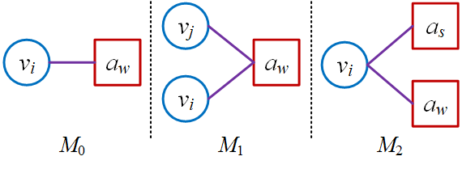
Methodology (Cont)
Construct Heterogeneous Graph G’
  Heterogeneous Relation E₂={(v_{i}, a_{w})}
    Explore Higher-order Substructure
    3 Motif {M₁, M₂, M₃}
    3 Relation Matrices {R₀∈R^{n×m}, R₁∈R^{n×m}, R₂∈R^{n×m}}
      (R_{t})_{iw} as co-occurrence counts of (v_{i}, a_{w}) in M_{t} (t∈{1, 2})
    Combine the normalized relation matrices
  Heterogeneous Adjacency Matrix B∈R^{(n+m)×(n+m)}
Node Relation E₁
Heterogeneous Relation E₂
Attribute Relation E₃

Slide 14
Methodology (Cont)
Learn Embeddings {x_{vi}, x_{aj}}
  Basic Unified Model
    Use the MF Obj. of DeepWalk [Jiezhong Q., 2018]
    Learn the Embeddings via SVD
    Use top-k singular values to approximate the reconstruction
    Adopt X* as the final result

Slide 15
Methodology (Cont)
Learn Embeddings {x_{vi}, x_{aj}}
  Side-Enhancement
  Use other side info. to enhance the learned emb.
  Based on Graph Regularization:
  Example Side Info.
    Community Structure – Modularity Matrix Q
    Attribute Similarity – Attribute Similarity Matrix S
  Side-Enhancement Obj.
Updating Rule:

Slide 16
Experimental Evaluation

Slide 17
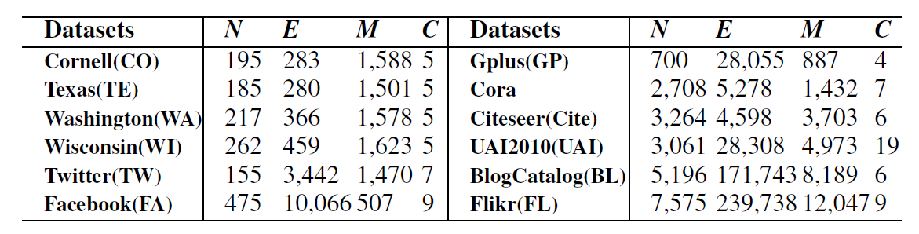
Experimental Evaluation
Performance Evaluation
  12 real attributed network
  11 Baselines/Competitors
    (Only) With Topo.
      High-Order Proximity: DeepWalk, node2vec, SDNE
      Community Structure: M-NMF, DNR
    With Topo. & Attribute
      TADW, AANE, FSCNMF
  Downstream Applications
    Node Clustering (a.k.a., Community Detection) – Metric: NMI, AC
    Node Classification – Metric: AC, Macro-F1

Slide 18
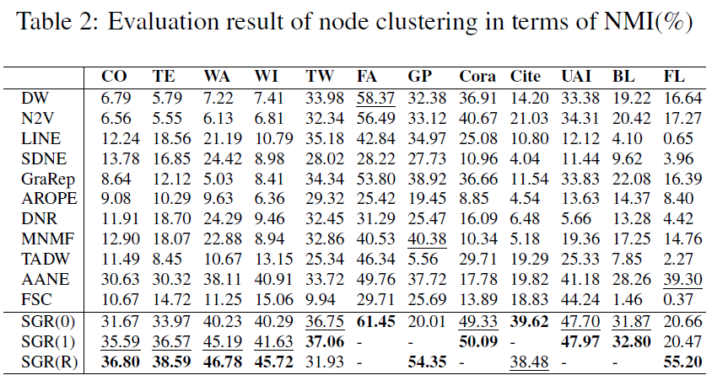
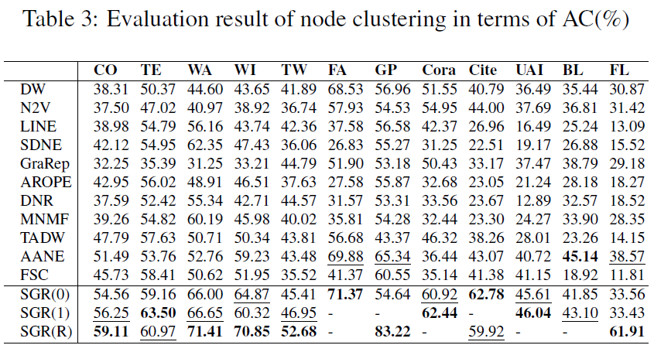
Experimental Evaluation (Cont)
Performance evaluation
  SGR(0): with Default Param. Setting
  SGR(1): with Fine-Tuned Param.
  SGR(R): with Side-Enhancement
  ‘-’: no further performance improvement

Slide 19
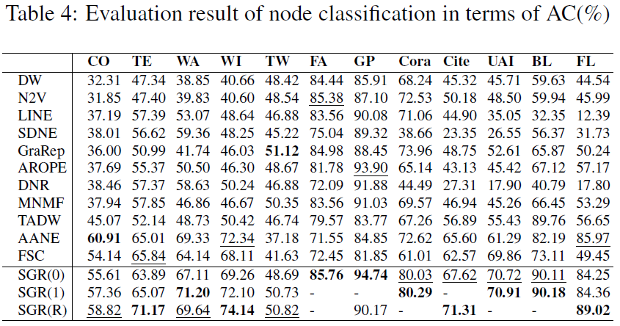
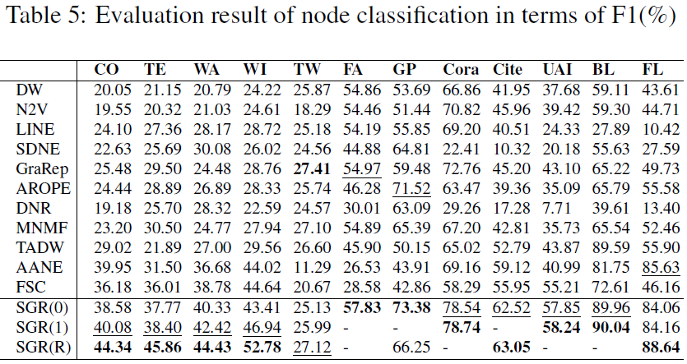
Experimental Evaluation (Cont)
Performance evaluation
  SGR(0): with Default Param. Setting
  SGR(1): with Fine-Tuned Param.
  SGR(R): with Side-Enhancement
  ‘-’: no further performance improvement

Slide 20
Experimental Evaluation (Cont)
Case study (for Semantic Community Detection)
  LastFM dataset
    Collected from online music platform
    With user friendship (topo.) and tag (attribute)
    Use X-means to determine Clustering Mem. of nodes & attributes
  t-SNE Dim. Reduction
    Vis. of Node & Attribute Emb.
    Vis. of Cluster Centers

Slide 21

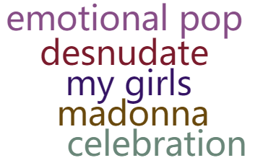

Experimental Evaluation (Cont)
Case study
  Generate Semantic Desc. for each node cluster (community)
  Select top-5 keywork (with min. dist.) for each Desc.
  Two Strategies:
    Case 1: 1 Comprehensive Desc. for each Community
    Case 2: Mutl. Topics for each community / 1 Desc. For each Topic
Case 1
Case 2

Slide 22
Conclusion

Slide 23
Conclusion
In this study
  Reformulate Net. Embedding in Attributed Network
  Introduce SGR
    Explore Non-linear High-order Proximity among Net. Struct. & Semantic
    Deal with Semantic-oriented application
In our future work
  A more comprehensive but simpler parameter setting strategy
  Reduce computation time via distributed SVD
Notes:
Here is the brief conclusion of this work.

Slide 24
Semantic Graph Representation Learning in Attributed Networks
Thank You Very Much!
Q&A
Meng Qin (megnqin_az@foxmail.com)

