Slide 1


BSMDMA Workshop @ IJCAI 2019
Prediction of Information Cascades via Content and Structure Integrated Whole Graph Embedding
Feng Xiaodong， Zhao Qihang, Liu Zhen
Speaker: Feng Xiaodong
From: University of Electronic Science and Technology of China
2019-8-11 Macao, China

Slide 2

CONTENT
1 Introduction
2 Related work
3 Methodology
4 Experiments
5 Conclusions

Slide 3



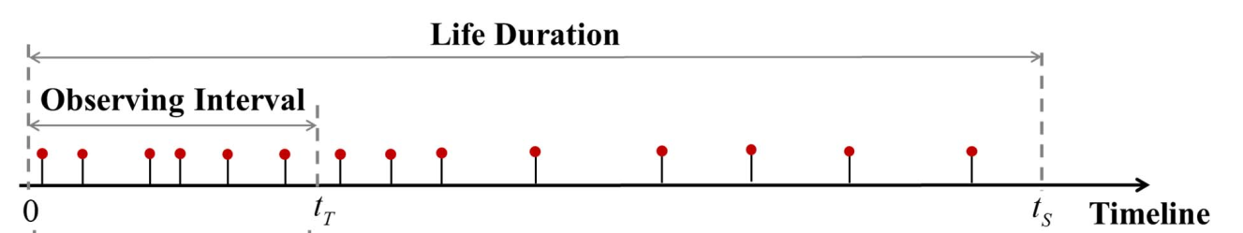
Background
The ubiquity emergence of online social platforms.
Being able to accurately predict the future size of information cascades will benefit both users and the owners of platforms a lot.
Though it is challenging to predict the popularity of these contents，many have proved the predictability of cascades and develop many methods to solve it

Slide 4
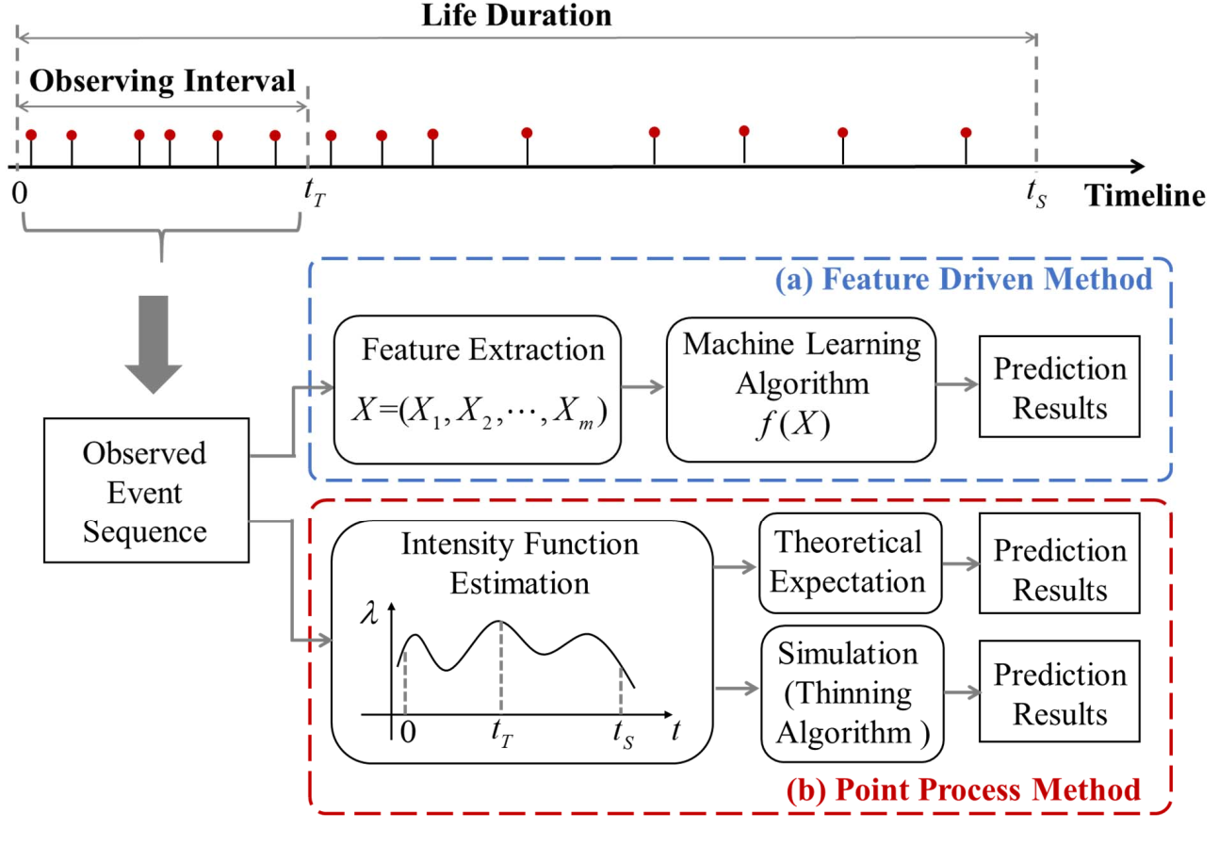
Background
feature-driven methods V.S. Generative approaches
Wu,.2018

Slide 5
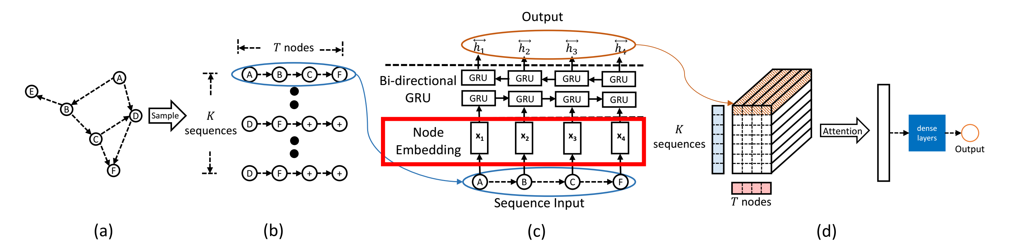
Background
While deep learning for graph learning have demonstrated their ability of dealing with nodes in graph for multiple tasks, including recommendation, node classification or clustering, as well as cascade prediction (DeepCas, Li 2017)
DeepCas is based on the node-level cascade graph embedding as the weighted average of representation of each node. Thus, how to design a robust system to learn the representation of graph as a whole is still a challenging task.

Slide 6
Our Work
Then the embedding of a cascade graph as a whole is learned by feeding graph² into a second order random walk to generate cascade sentence as the input of semi-supervised Skip-gram, followed by a Multiple Layer Perception (MLP) to map the learned embeddings to the growth size of information cascades.
We present a novel deep learning framework to predict the size of information cascade, which first constructs a new high-level graph (noted as graph²) with each cascade graph is analogous to the vertices in graph².
To design the edges in graph², we respectively develop content-based (noted as DeepCon) and structure-based (noted as DeepStr) ways to measure how much each pair of two cascade graphs share the identical influential users and how similar the dynamic process of cascade is.
The proposed method is evaluated on real information cascade datasets by comparing with baselines
Notes:
, since the future size of an information cascade corresponds to the whole graph that depicts the process of the cascade, not each node in the graph

Slide 7

2 Related Works

Slide 8
Cascade Prediction
DeepCas
Using the latest deep network technology as an end-to-end cascade prediction method, automaticly learning cascade representation(Li et al., 2017
）
Feature-driven approaches treat it as a classification task.(Gao et al., 2014
)
…
DeepHawkes
Feature-driven approaches treat it as a regression task.(Pinto et al., 2011)
Generative approaches typically consider the gain of cascade popularity as a cumulative stochastic process(Yu et al., 2015)
extended DeepCas to consider the time decay effect by means of Hawkes process (Cao et al., 2017).

Slide 9
Graph Representation
node2Vec generated biased second order random walks rather than uniform ones.Struc2vec can learn the representations for the structural identity of nodes。（Li et al., 2016&Ribeiro et al., 2017
）
Word2Vec was proposed to learn distributed dense representation of words from sparse text corpus based on Skip-Gram.(Mikolov et al., 2013)
…
DeepWalk was first proposed to learn the language model from a network by using random walks to generate sequences of nodes from a network.(Perozzi et al., 2014）
Some others exploited deep learning frameworks, such as autoencoder to learn the embedding of network.（Wang et al., 2016& Gao and Huang, 2018
）
Graph representation to learn embedding the nodes in a graph, is instrumental for machine learning tasks that focused on network data, such as Laplacian Eigenmaps.(Belkin and Niyogi, 2002
)

Slide 10
Methodology

Slide 11
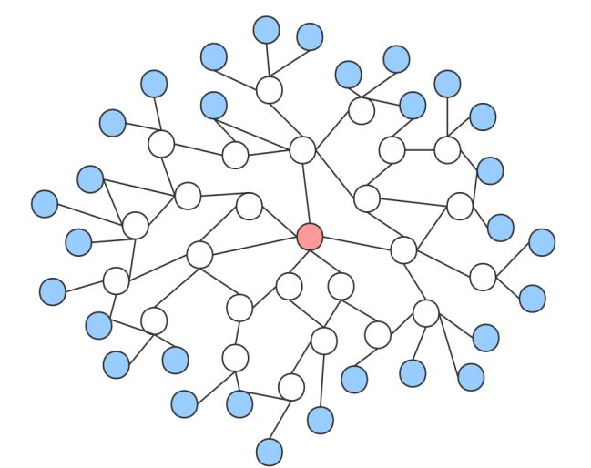
Problem Definition
global network
G = (V, E) where V is the set of vertices and E ⊂ V × V is the set of edges. A node i represents an actor, e.g., a user in Twitter or an author in the academic paper network, and an edge (i, j) ∈ E represents a social tie, e.g., retweeting or citation between nodes i and j.
1
2
Let C be the set of cascades, containing numbers of cascades as C={c}. Each snapshot of cascade c at time t is described by a subgraph gct =(Vct, Ect) ∈ G, Vc is a subset of nodes in V that have contributed for the cascade c at observed time
cascade graph
Forwarding Twitter/paper Citation
Notes:
加两个示例图

Slide 12
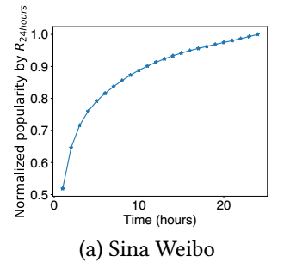
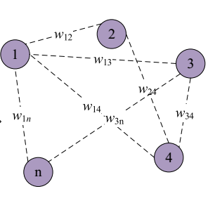
Problem Definition
growth size
}
3
It can be described as the increment of the size of cascade c after a given time interval Δt, denoted as ΔVc=|Vct+Δt |-|Vct|. The growth size of a cascade is exactly what we are concerned about and to predict given global network G and cascade graph g
4
High order cascade graph: Graph²
Given a cascade set C, we define the high order cascade graph to encode the similarity between cascades as Graph²= (C, E², W), where E² is the extracted similarity-based links between cascades and W is the corresponding weight
Cascade graph

Slide 13
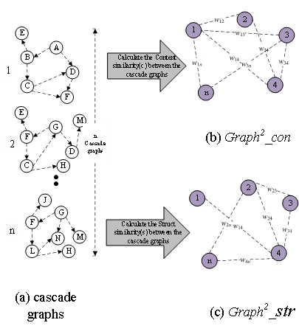
Constructing High order Graph containing Cascades
Let g1 = (V1, E1), g2 = (V2, E2) denote two cascade graphs with V1, V2 denoting the vertex sets and E1, E1 denoting the edge sets correspondingly. The content similarity between them is determined by how many common nodes shared in V1 and V2 weighted by the influence of nodes
It has been empirically examined by hand-crafted features that different topological structures may result in different potential dissemination trend of cascades, and thus make difference for growth size. Therefore, we then propose to measure the structural similarity between different cascade graphs to automatically learn the structural features from the High order cascade graph (Graph²_str) based on it.

Slide 14
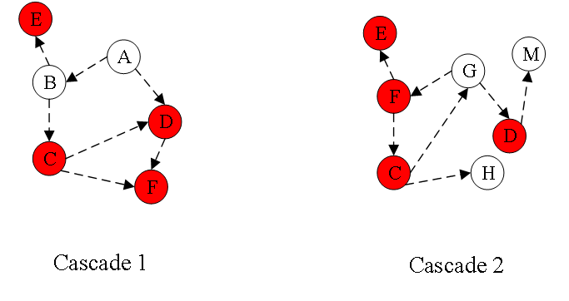
Content Similarity
Finding their common nodes
Calculating Content Similarity
Content Similarity is measured as：
where deg(v) denotes the degree of node v in global network G.
Each node in the Graph²_con represents a cascade graph. Weight refers to the content similarity between two cascade graphs.
Constructing High order Graph

Slide 15

Structural Similarity
Finding their root nodes
Finding the K of two cascade
K is the minimum value of maximum distances K₁ and K₂ over all nodes to the root nodes. In cascade 1, K₁ = 2; and in cascade 2, K₂=3,so the K=min(K₁,K₂)=2
In cascade 1, root node is A; in cascade 2, root node is G.
In this figure, yellow represents the root node, red represents the point whose distance from the root node is 1, and blue represents the point whose distance from the root node is 2.
Constructing ordered degree sequences
As shown in the figure, for cascade 1,2, their node sequence is:
1:k=0:(A) k=1:(B,D) k=2:(E,C,F) 2:k=0:(G) k=1:(F,N,M) k=2:(J,L),
so their ordered degree sequences is:
seq1:k=0:(2) k=1:(1,2) k=2:(0,0,2) seq2:k=0:(3) k=1:(0,0,2) k=2:(0,2)
where l(s1, s2) will be measured by adopting DTW.
Each node in the Graph²_str represents a cascade graph.
Calculating Structural Similarity
Constructing High order Graph

Slide 16
Dynamic Time Warping（DTW）
a₁₁ | a₁₂ | a₁₃ | …… | a_{1m}
a₂₁ | a₂₂ | a₂₃ | …… | a_{2m}
…… | …… | …… | …… | ……
a_{n1} | a_{n2} | a_{n3} | …… | a_{nm}
For ease of understanding, we give the following definitions：
Definition 1(Warping Distance):Given two sequences:Q=(q1,q2,…qm),C=(c1,c2,…cn),Warping Distance refers to the distance between an element in Q and an element in C, denoted as d. In our paper, d is measured as:
a,b belong to two sequences of Q and C respectively.
Definition 2(Warping Matrix):Given two sequences:Q=(q1,q2,…qm),C=(c1,c2,…cn),A matrix is an n * m matrix, denoted as A.Each element a_{ij} in A represents the distance d between the ith element of C and the jth element of Q.
Definition 3(Cumulative distance):Represents the sum of the shortest distances from the a₁₁ element in A to the a_{ij} element,denoted as Cd_{ij}.
Definition 4(Warping Path):A shortest path through matrix A starting from a₁₁ and ending from a_{nm}. In particular, it is pointed out that in order to satisfy the requirements of boundary conditions, continuity and monotonicity, only three directions are allowed for each lattice point of the matrix (as shown in the figure), and only one step can be taken at a time.
a_{ij} | a_{i,j+1}
a_{i+1,j} | a_{i+1,j+1}
The goal of DTW is to find an optimal Warping Path to minimize the Cumulative Distance, so as to find the optimal alignment between two sequences, which can be expressed in mathematical language as follows:
The Cumulative Distance can be calculated by the following formula:
Notes:
结构相似度这儿再用两个图的计算例子详细解释下？涉及里面DTW的计算 及k=1：K这样的循环 看不能形象的描述，这一部分也是方法的核心，后面投稿期刊也需要。

Slide 17
Dynamic Time Warping（DTW）
2
3
2
0.5(0.5) | 1(1.5) | 1(2) | 0(2)
1(1.5) | 0.5(1) | 0.3(1.3) | 0.5(1.8)
0.5(2) | 0(1) | 1(2) | 0(1.3)
Firstly,let us give two sequences:
Q=(3,2,4,2)
C=(2,3,2)
Secondly,Draw a 3 *4 Warping Matrix A. Any element a_{ij} in the matrix represents the distance between the ith element of C sequence and the jth element of Q sequence. To facilitate the following calculations, the values in parentheses are Cumulative Distances
3 | 2 | 4 | 2
and then we start to do DTW,In fact, it is to find a shortest path through A starting from the upper left corner of A and ending at the lower right corner of A.According to the Cumulative Distances in the matrix, we can easily find the shortest Wraping Path:
(1,1)->(2,2)->(2,3)->(3,4)
2 | 3 | 2
According to the Wraping Path, we can find the best alignment of Q and C sequences (as shown in the figure).
3 | 2 | 4 | 2
Notes:
结构相似度这儿再用两个图的计算例子详细解释下？涉及里面DTW的计算 及k=1：K这样的循环 看不能形象的描述，这一部分也是方法的核心，后面投稿期刊也需要。

Slide 18
Learning a Semi-supervised Language Model
The biased random walk in Node2Vec that considers both breadth-first and depth-first sampling strategies is applied to generate context for cascades from Graph²
Notes:
再加一页 展示论文中目标函数那一部分吧？

Slide 19

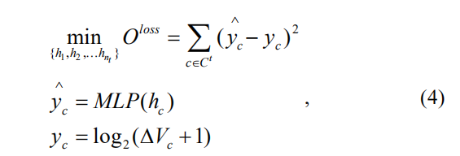

Learning a Semi-supervised Language Model
The semi-supervised language model is reached by optimizing the following objective as:
By extending the Skip-gram framework to cascades, the following objective can be optimized to maximizes the log-probability of observing the cascade neighborhood N(g) for all g ∈ C, as:
We integrate to minimize the square loss between predicted growth size and ground truth into Eq. (3), where we exploit a multi-layer perception (MLP) as an end-to-end prediction as:

Slide 20
Experiment

Slide 21
Data sets and Evaluation Metric
AMINER data set
Weibo data set
Evaluation Metric
We have sorted out and selected 1565 cascade graphs, which contain 108839 nodes. Each node represents a Weibo user. Then, according to the selected cascade graphs, we construct a global social network G, which contains the relevant information how all nodes are connected. Next, we randomly selected 1200 diagrams from 1565 cascade diagrams as training set, 195 diagrams as validation and 170 diagrams as testing.
We use the mean square error (MSE) of the test data set to evaluate the accuracy of the prediction, which is a common choice for regression tasks and was used in previous cascade prediction works.
The data set consists of a global network and three cascade network sets. There are 9860 nodes and 560 cascade graphs in the data set, each node representing the author of a paper, simultaneously, a cascade graph composes by the author and the citer of a paper. The global network G based on citations between 1992 and 2002. The training set consists of papers published from 2003 to 2007. Papers published in 2008 and 2009 are used for validation and testing.

Slide 22
Baseline methods
01
02
03
04
Feature-linear
Node2vec
DeepCas
Our methods
We select several features of cascade graph and using linear regression with L2 regularization to predict
We learn two embedding vectors from global graph and cascade graph, and join them together to form a new embedding for each node. The average of embeddings of all nodes in a cascade graph is fed into MLP to make the prediction.
an end-to-end neural network framework that takes as input of the cascade graph and predicts the growth size.
We use DeepCon, DeepStr and DeepCon+DeepStr to denote the three variants of our proposed methods, which take the embedding from Graph2_con, Graph2_str and both two as the input of MLP.

Slide 23
parameter settings
We sample K = 200 paths each with length T = 10 from the cascade graph for DeepCas as suggested. For proposed DeepCon and DeepStr, we set T=14. The iteration number is 1000.
For DeepCas, consistent with [Li et al., 2017], the mini batch size is set to 32 and the smoother is set to 0.01. The node2vec hyper parameters p and q are set to 1
The final sizes d of embedding when fed into a 4-layer MLP for the both data set are set to 64

Slide 24
Performance
improvement of prediction accuracy

Slide 25
Performance
reduction of computational complexity

Slide 26
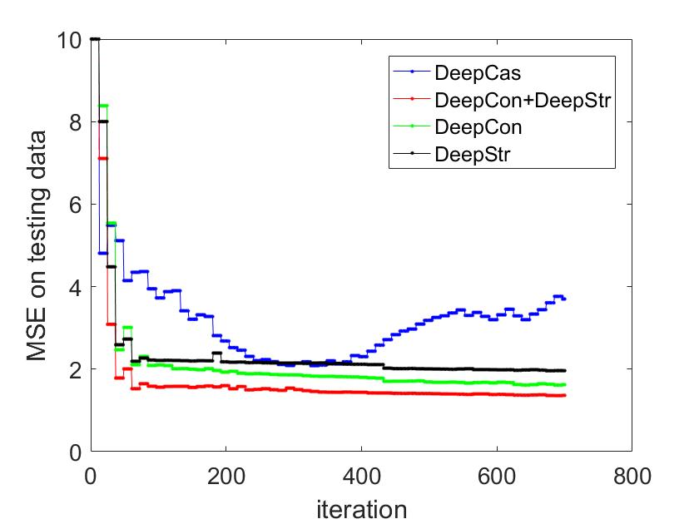
Performance
Robust results

Slide 27
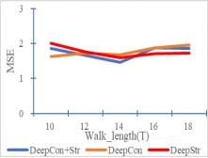
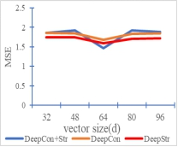
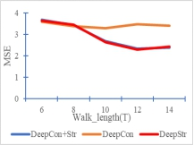
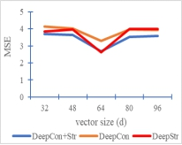
Parameter Sensitivity
It is found that with the increase of T, the prediction declines at first and keep stable. This was can be explained that as the number of cascades in the sequence increase, the effect of each walk would capture more context within cascades and will reach a boundary.
For d the optimal size is 64 as smaller vector will ignore some potential features and larger vector contains some redundant information.
(a) MSE v.s. walk length on AMINER
(b) MSE v.s. vector size on AMINER
(c) MSE v.s. walk length on Weibo
(d) MSE v.s. vector size on Weibo

Slide 28
Conclusions
Conclusion 2
Conclusion 4
A high-order graph is firstly constructed to capture the node-content and structure similarity, followed by a semi-supervised skip-gram model by integrating minimization of the estimated loss of training cascades with MLP predictor.
One important future work would be how to encode other rich information if available in addition to the graph structure and node identities of cascades
Conclusion 1
Conclusion 3
Conclusion 5
We present a end-to-end deep neural network model for cascade prediction by learning the embedding of the cascade as a whole rather than aggregating embeddings of each nodes in cascade.
The proposed method can perform better than feature-based and node embedding-based methods, with lower computation cost and robust results over iterations.
how to exploit other deep neural network, e.g. autoencoder, recurrent neural network, to improve the prediction accuracy.

Slide 29
THANKS for Your attention!

