Slide 1


Relevant Structure Search in Graph Databases: Methods and Applications
Yuanyuan Zhu∗, Xin Huang†
∗Wuhan University, China
†Hong Kong Baptist University, Hong Kong, China
yyzhu@whu.edu.cn, xinhuang@comp.hkbu.edu.hk

Slide 2
Outline
Introduction and preliminaries
Part I: Similarity search in graph databases
  Subgraph similarity search
  Supergraph similarity search
  Graph similarity search
Part II: Community search in a single graph
  Non-attributed community search
  Attributed community search
Summary

Slide 3
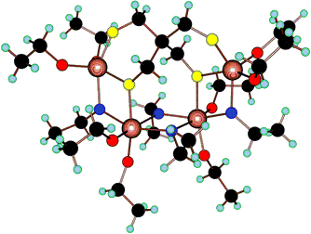
What is a graph?
Graph is a mathematical structure composed of vertices connected by edges
Vertices = A collection of entities which have properties that are somehow related to each other
  e.g., people, proteins, webpages, organisms,…
Edges = Connections between vertices
  may be real and fixed (rivers),
  real and dynamic (friendships),
  abstract with physical impact (hyperlinks),
  purely abstract (semantic connections between concepts).

Slide 4



Graphs - why should we care?
Graph has 3V characteristics of big data (Volume)
70+ billion facts in knowledge graphs in 2016
2+ billon active users in 2017
190 friends/user on average
1.5+ billon users in 2017
Notes:
WeChat is a Chinese mobile APP developed by Tencent, and it has a wide range of functions such messagaing, social media, and mobile payment.

Slide 5

Graphs - why should we care?
Graph has 3V characteristics of big data (Velocity)
Fast flowing data
Evolving data structures and relationships
Notes:
In every second, 98000 nighty eight thousand tweets will be generated
370，000 three hunderd and seventy thousand minutes voice calls will be made.

Slide 6
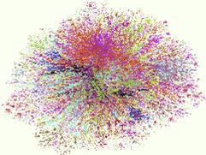
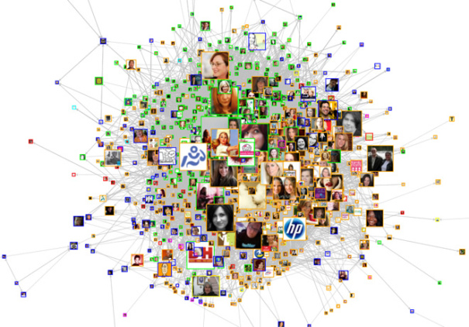
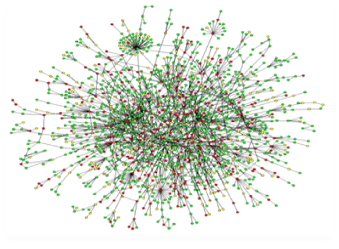
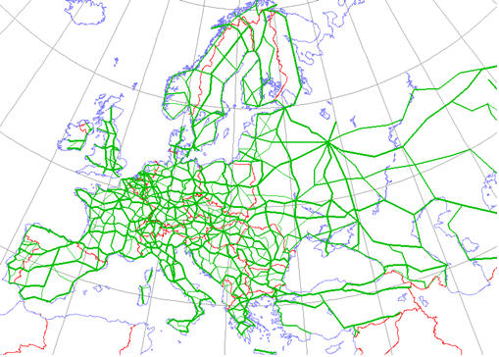
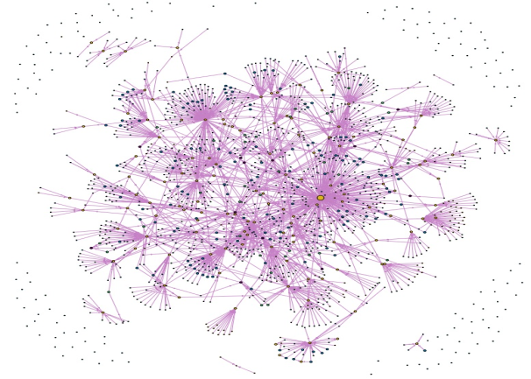
Graphs - why should we care?
Graph has 3V characteristics of big data (Vareity)
Web Graph
Social Network
PPI Network
Road Network
Chemical Compound
Ontology Graph
Notes:
Graph also have a wide range of applications' such as……

Slide 7
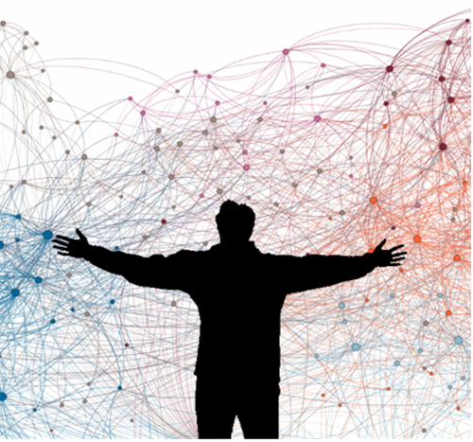
How to deal with the graph data?
Notes:
So the question is,how to deal with so many graph with so size in various applications?

Slide 8
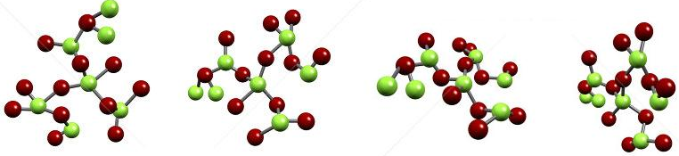
Two scenarios of graph databases
A collection of small graphs
  e.g., chemical compound structure database
A single (large) graph
  e.g., a social network
Notes:
Before we get into the specific topics in this tutorial, I,d like to introduce two difference settings of graph databases.

Slide 9
Outline
Introduction and preliminaries
Part I: Similarity search in graph databases
  Subraph similarity search
  Supergraph similarity search
  Graph similarity search
Part II: Community search in a single garph
  Non-attributed community search
  Attributed community search
Summary
Notes:
In this tutorial, for each topic, we will cover the main solutions. And to make it is easier to understand the main techniques, we will mainly introduce the techniques of the state of the art methods.

Slide 10
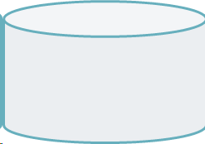

Similarity search in graph databases
Given a graph database G and a query graph q, find all graphs that satisfy certain constraint.
  (Approximately) containing the query
  (Approximately) contained by the query
  Similar to the query
Graph database G
Query q
D
B
B
C
B
C
C
B
A
B
A
B
E
A
B
C
A
C
g₁
g₂
g₃

Slide 11
Why it is challenging?
Involves a lot of NP-complete operations
  Subgraph Isomorphism
  Graph edit distance
  Maximum common subgraph
Remain challenging even with index
  Exponential number of possible subgraph features
  Searching subgraph features involves subgraph isomorphism test.

Slide 12
Subgraph containment search
Given a graph database D and a query graph q, retrieves all graphs that containing q from D.
  Subgraph isomorphism is to determine whether g_{i} contains a subgraph that is isomorphic to q.
q
g₁
g₂

Slide 13
Subgraph containment search
Processing flow
Filtering :
  Feature-based index is used to filter out the negative results and generate a candidate set.
Verification:
  Precise subgraph isomorphism testing to generate final results from the candidate set.
Candidate
graph set C_{q}
Answer
graphs
Query
Filtering
Verification

Slide 14
An example
q
×
g₁
g₂
g₁
---
q
g₁
g₂
q
g₁
g₂
---
g₁
---
q
g₁
g₂
---

Slide 15
Subgraph containment search (related work)
What features to select for filtering?
GraphGrep (Path). Shasha et al, PODS ’03
Daylight FP (Path) James et al, Daylight Th. Manual ’05
GraphGrepSX (Path) Bonnici et. al, PIRB ’10
SING (Path+Locality) Natale et al, BMC Bioinformatics ’10
CT-index (Tree) Klein et al. ICDE ’11
GDIndex (Graph) Williams et al. ICDE ‘07
gIndex (Frequent Subgraph). Yan et al., SIGMOD ’04
FG-Index (Frequent Subgraph) Cheng et al., SIGMOD ’07
TreePi (Frequent Tree) Zhang et al., ICDE ’07
Tree+Delta (Frequent Tree) Zhao et al., VLDB ‘07
Frequent pattern based approach
Exhaustive enumeration based approach
Precise Subgraph Isomorphism Test in Verification Phase.
  Ullamnn’s Backtracking Algorithm. J. ACM ’76
  VF2, Cordella et al., PAMI‘04.
  SwiftIndex, Shang et al., VLDB ’08.
  Detailed Comparison and Evaluation in iGraph, Han et. al., PVLDB ’10
Notes:
Ullamnn’s Backtracking Algorithm. J. ACM ’76
Ullamnn’s Backtracking Algorithm. J. ACM

Slide 16
Subgraph containment search
GraphGrep,Shasha et al. PODS’02
First work adopts the filtering-and-verification framework
  Enumerate the set of all paths (length <= L) of all graphs in D
  Discard a graph whose value in fingerprint is less than the value in query fingerprint
D
B
B
B
C
B
C
C
Candidates
= {g₁, g₃}
A
C
A
B
A
B
E
A
B
C
Query q
g₁
g₂
g₃
AB:1
AC:1
BAC:1
Index
Key | g₁ | g₂ | g₃
h(AB) | 2 | 2 | 1
h(AC) | 1 | 0 | 1
h(BAC) | 2 | 0 | 1
Verification

Slide 17
Subgraph containment search gIndex,Yan et al. SIGMOD’04
Solution
  Use frequent subgraphs instead of path as the basic index feature
A
A
Size=1
Size=2
Size=3
Size=4
B
A
A
A
A
B
A
A
B
A
B
B
A
A
A
A
F=3
F=3
B
A
B
B
A
B
F=2
F=1
F=1
B
B
A
B
B
F=4
F=3
A
B
A
A
A
A
A
B
B
A
B
A
B
B
B
F=3
F=2
F=1
F=1
A
B
B
B
B
F=1
A
A
B
A
A
B
A
A
F=2
B
B
B
A
B
B
F=1
F=2
Notes:
The frequency of a feature is the number of graphs it occurs in.

Slide 18
Subgraph containment search gIndex,Yan et al. SIGMOD’04
Select discriminate frequent subgraphs to eliminate the redundancy
D_{x}<< ∩ D_{f} ( f)
Size=2
Size=3
g₁
A
A
A
A
g₃
f₁
A
A
B
f₃
A
A
B
B
B
B
D_{f1}={g₁, g₂, g₃}
g₂
A
A
g₄
A
B
f₂
D_{f3}={g₂, g₃}=D_{f1}∩D_{f2}
A
B
B
B
B
D_{f2}={g₂, g₃, g₄}
A
B
B
Notes:
For a feature x, suppose Dx is the set of graphs it occurs. For example We only select the feature whose frequency is far smaller than the intersection of their subfeatures. Since the pruning power is the same with the union of df1 and df2.

Slide 19
Subgraph containment search gIndex,Yan et al. SIGMOD’04
gIndex Tree
  Prefix tree which consists of the edge sequences of discriminative fragments
  Record all size-n discriminative fragments in level n
  Black nodes ➔ discriminative fragments
  White nodes ➔ redundant fragments; for Apriori pruning
Query
<e₁, e₂, e₃, e₄, e₅>
Level 0
e₁
Fragments
<e₁>
<e₁, e₂>
<e₁, e₂, e₃>
<e₁, e₂, e₃, e₄> ➔ stop
<e₂>
…
Level 1
e₂
f₁
Level 2
f₂
e₃
…
f₃
gIndex Tree

Slide 20
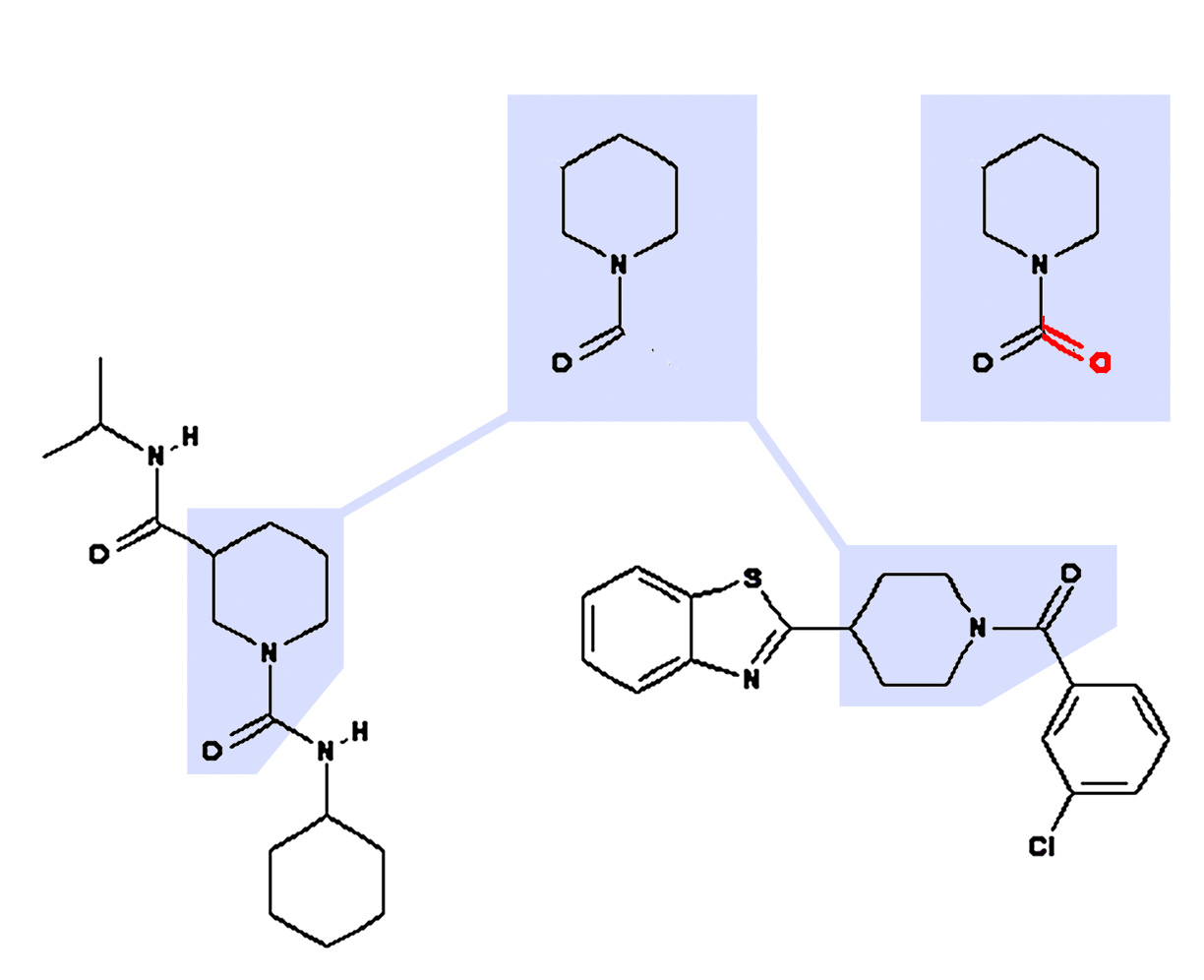
Subgraph Similarity Search
Why Similarity Search?
Input Mistake
Exploration
......
Related Work
Grafil, Yan et al. SIGMOD ’05
C-Tree, He et al. ICDE’06
GDIndex,Williams et al. ICDE’07
Comparing Stars, Zeng et al. VLDB’09
Grafil+, Shang et al. SIGMOD ’10.
Notes:
oxygen 核心词汇
英 [‘ɒksɪdʒən] 美 [’ɑːksɪdʒən It it because we might have input mistake when we search. Or we are not very sure the concrete structure of chemical compound we are looking for. Because as you know, not everyone is an expert in some fields.

Slide 21
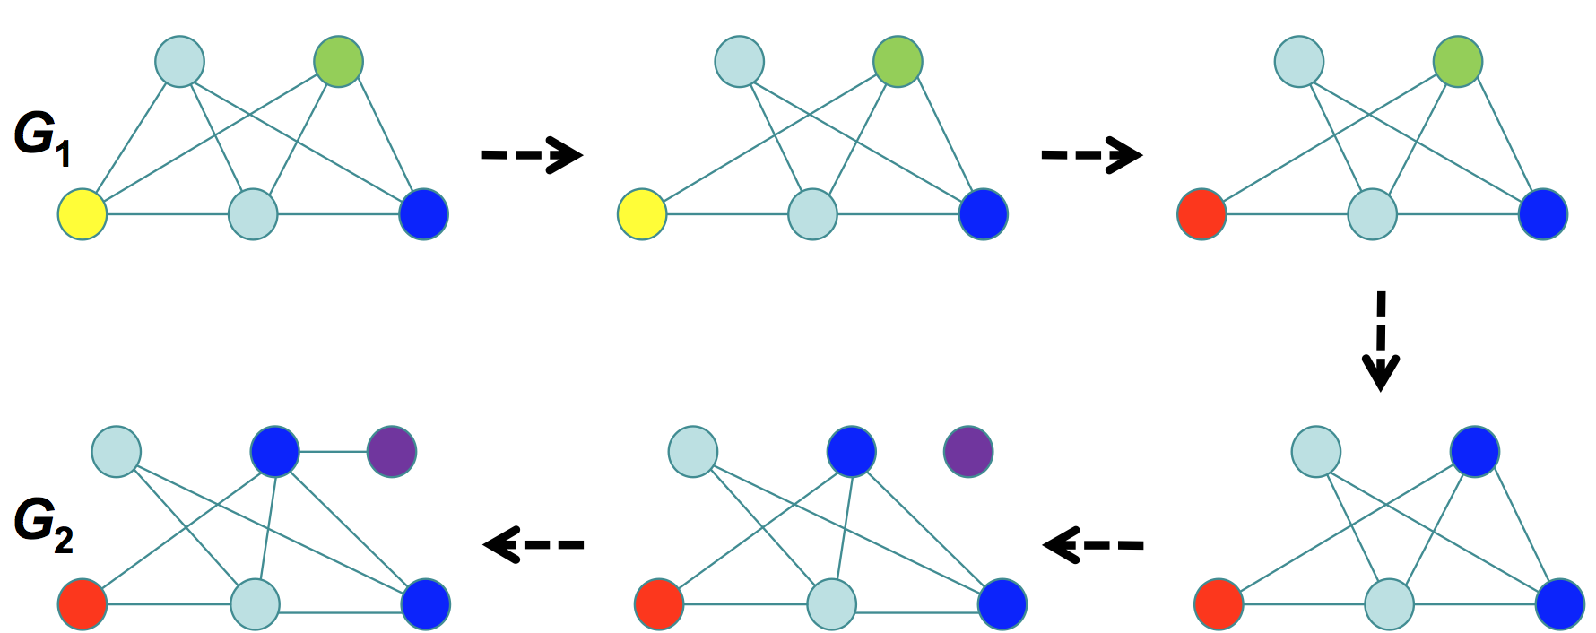
Basic similarity measures
Graph Edit Distance (GED)
  The minimum amount of distortion that is needed to transform one graph into another (node relable, deletion, insertion, edge deletion and insertion)
Notes:
Five

Slide 22
Basic similarity measures
Maximum Common Subgraph (MCS)
  The maximum subgraph contained in both graphs
  GED computation is equivalent to the MCS computation under a certain cost function. (H.Bunke, PRL 1997）
C
B
C
B
A
C
C
C
B
C
B
D
C
C
Notes:
In this paper, we define a new graph similarity measure based on MCS, which can also be equivalent to GED under a certain cost function [28]. A maximum common subgraph of two graphs gl and g2 is a subgraph of both gl and g2 such that there is no other subgraph of gl and g2 with more nodes. Graph edit distance and maximum common subgraph are well known concepts that have various applications in pattern recognition and machine vision
Actually, under a certain cost function ,these two measures can be equivalent. This has been proved by in 1997.

Slide 23
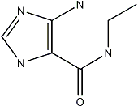
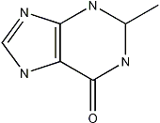
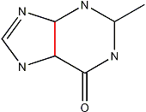
Subgraph similarity search
Grafil, Yan et al. SIGMOD ’05
Each graph is represented as a feature vector X = {x₁, x₂, ..., x_{n}}
The similarity is defined by the distance of their corresponding vectors
QUERY GRAPH
…
Notes:
Triangle美 pentəgɑ:n [ˈheksəgɑ:n] represent by small fragments such as triangles pentagon and hexegon. The intuition is that if two graphs are similar. their vectors must be similar.

Slide 24
Subgraph similarity search
Grafil, Yan et al., SIGMOD ’05
Graph (G₁)
If graph G contains the major part of a query graph Q, G should share a number of common features with Q.
Query (Q)
Graph (G₂)
Given a relaxation ratio k, calculate the maximal number of features J that can be missed !
Substructure
Notes:
Suppose we can delete any red edge in the query graph Q. If we allow k edges to be relaxed, J is the maximum number of features to be hit by k edges—it becomes the maximum coverage problem

Slide 25
Subgraph similarity search
Grafil, Yan et al. SIGMOD ’05
 | G₁ | G₂ | G₃ | G₄ | G₅
f₁ | 0 | 1 | 0 | 1 | 1
f₂ | 0 | 1 | 0 | 0 | 1
f₃ | 1 | 0 | 1 | 1 | 1
f₄ | 1 | 0 | 0 | 0 | 1
f₅ | 0 | 0 | 1 | 1 | 0
features
Assume a query graph has 5 features and at most 2 features to miss due to the relaxation threshold.
Notes:
[ˌrilækˈseʃən]

Slide 26
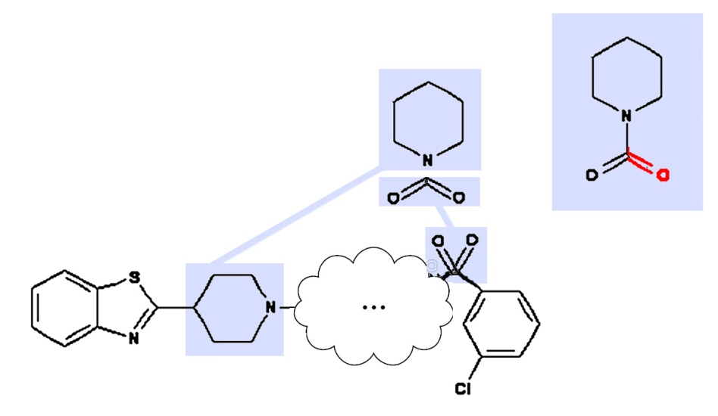
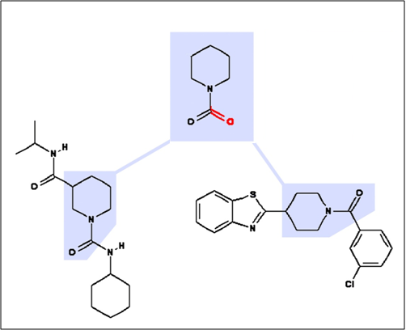
Subgraph similarity search
Grafil+, Shang et al. SIGMOD ’10
A New Similarity Measure.
Maximum Connected Common Subgraph – MCCS
(counting missing edges while retaining the connectivity)

Slide 27
Subgraph similarity search
Grafil+, Shang et al. SIGMOD ’10
Subgraph Distance: Given a query graph q and a database graph g, the Subgraph Distance is defined as,
dist(q, g) = |q| − |mccs(q, g)|
The graph size is defined as the number of edges.
(# of missing edges from the query)
Substructure Similarity Search: Given a graph database D = {g₁, g₂, ..., g_{n}}, a query graph q, and a subgraph distance threshold , the substructure similarity search is to retrieve all the graphs g_{i} ∈ D with dist(q, g_{i}) ≤ .

Slide 28
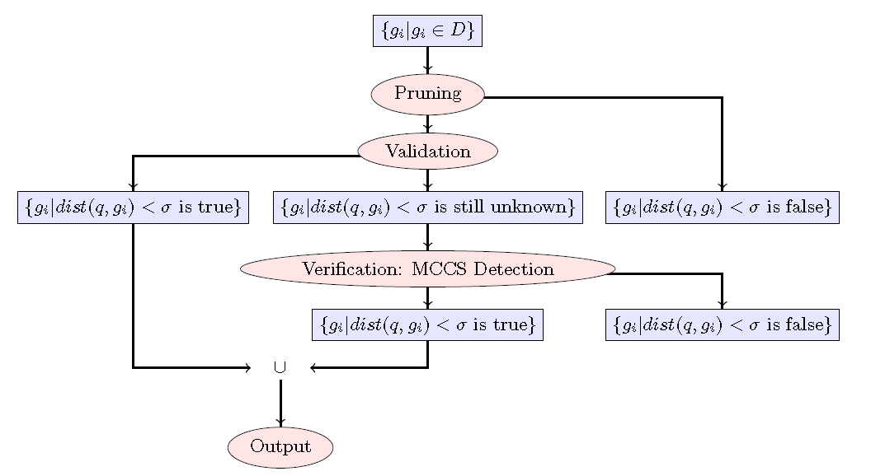
Subgraph Similarity Search
Grafil+, Shang et al. SIGMOD ’10
Notes:
The connectivity of mccs(g1,g2) dominates the connectivity of g2 if there is a subgraph isomorphic map- ping F from mccs(g1, g2) to g2 (i.e. mccs(g1, g2) ⊆F g2) such that if removing a set S of edges in mccs(g1,g2) causes mccs(g1,g2) disconnected, then removing F(S) in g2 always causes g2 disconnected.

Slide 29
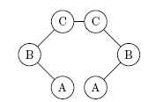
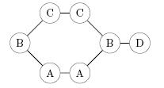
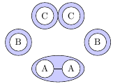
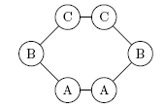
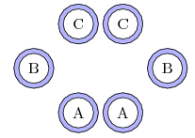
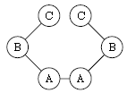
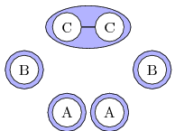
Subgraph similarity search
Grafil+, Shang et al. SIGMOD ’10
Theorem. Given three graphs g₁, g₂, and g₃, if the connectivity of mccs(g₁, g₂) dominates g₂ or the connectivity of mccs(g₃, g₂) dominates g₂, then dist(g₁, g₃) ≤ dist(g₁, g₂) + dist(g₂, g₃).
Example 1
mccs(g₁,g₂) not dominate g₂
mccs(g₂,g₃) dominates g₂
Example 2
mccs(g₁,g₂) not dominate g₂
mccs(g₂,g₃) not dominate g₂
g₁=Query g₂=Feature(Index) g₃=Data
Notes:
The connectivity of mccs(g1,g2) dominates the connectivity of g2 if there is a subgraph isomorphic mapping F from mccs(g1, g2) to g2 (i.e. mccs(g1, g2) ⊆F g2) such that if removing a set S of edges in mccs(g1,g2) causes mccs(g1,g2) disconnected, then removing F(S) in g2 always causes g2 disconnected.

Slide 30
Subgraph similarity search
Grafil+, Shang et al. SIGMOD ’10
dist(Q,F)+dist(F,D) ≥ dist(Q,D)
Validation Rule 1:
dist(Q,F)+dist(F,D) ≤ => dist(Q,D) ≤
mccs(Q, F) dominates F or mccs(F, D) dominates F
dist(Q,D)+dist(D,F) ≥ dist(Q,F)
Pruning Rule 1:
dist(Q,F)-dist(D,F)> => dist(Q,D)>
mccs(D, F) dominates D
dist(F,Q)+dist(Q,D) ≥ dist(F,D)
Pruning Rule 2:
dist(F, D)-dist(F, Q)> => dist(Q,D)>
mccs(F, Q) dominates Q

Slide 31
Given a graph database D and a query graph q, retrieves all graphs that is contained by q from D.
  Subgraph isomorphism is to determine whether q contains a subgraph that is isomorphic to g_{i}.
q
g₁
g₂

Slide 32
Supergraph containment search
CIndex, Chen et al. VLDB’07
Select a feature set F from graph database D. If feature f∈F is not a subgraph of q, then the graphs having f as subgraph are pruned.
Search: Test indexed features in F against the query q which returns all f⊆q, and compute the candidate query answer set C_{q}.
Verification: Check each graph g in the candidate set C_{q} to see whether g is really a subgraph of q.
.
Notes:
The idea is similar to subgraph containment search, but the the process is to prune graphs whose feature are not included by the query.

Slide 33
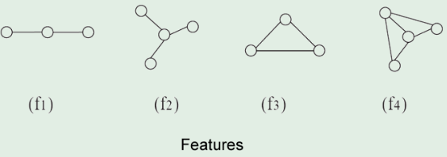
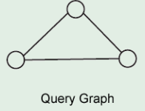
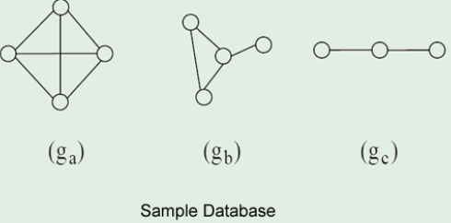
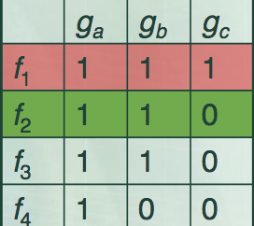
Supergraph containment search
CIndex, Chen et al. VLDB’07
×

Slide 34
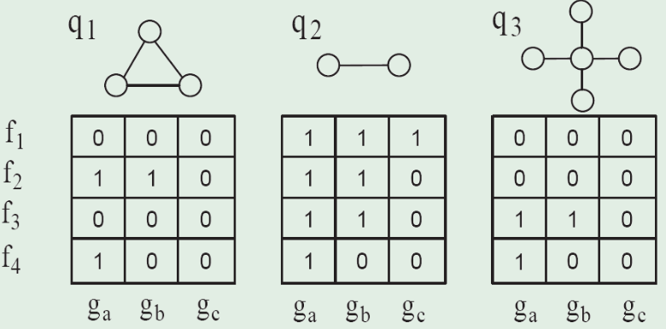
Supergraph containment search
CIndex, Chen et al. VLDB’07
Contrast graph matrix
  Set i-th row to 0 if the query has feature fi as its subgraph
  Concatenate feature graph matrix to form a global matrix.
  Fi covers a set of columns -> Maximum Coverage
Notes:
As we know, there are many possible subgraphs can be considered as features in the graph database, and the question is the How to choose the appropriate features? The main idea is to construct a contrast graph matrix.
It is derived from the feature-graph matrix， but we set its ith row set to 0 if the query has feature fi. Figure 6 shows three query graphs and their corresponding contrast graph matrix for the 4 features and 3 model graphs shown in Figure 4 and Figure 2. [kɑnˈkæt(ə)ˌneɪt] Each time select row i with most non-zero entries in M; then removes this row and all columns covered by it. This process repeats until no row can cover at least r columns.
Towards Graph Containment Search and Indexing

Slide 35
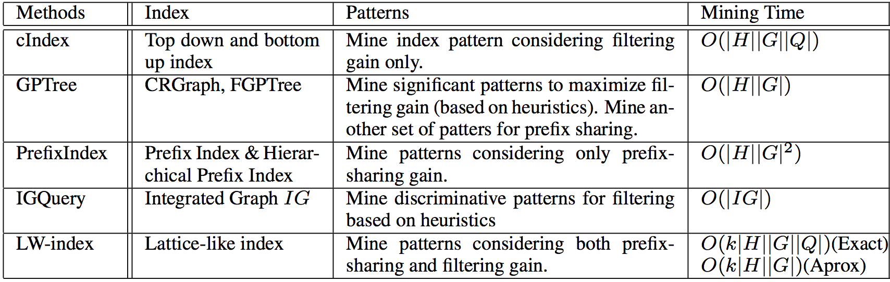
Supergraph containment search
(related work)
CIndex, Chen et al.V LDB’07
GPTree , Shang et al. EDBT’09
PrefixIndex ，Zhu et al. SSDBM’ 10
IGQuery, Cheng et al. TOD’09
LW-index, Yuan et al. VLDB’13

Slide 36
Supergraph similarity search
Given a graph database D and a query graph q, retrieves all graphs that is approximately contained by q from D.
  GED or MCS is used to compute the distance between q and g_{i}.
Q
G₁
G₂

Slide 37
Supergraph similarity search
Shang et al. Sigmod’10
dist (Q, G) = |E(G)|− |E(mcs(Q, G))|
dist (Q, G₁) = 3-1=2 dist (Q, G₂) = 5-4 =1
Q
G₁
G₂
Notes:
It is the number of extra edges contained by G.

Slide 38
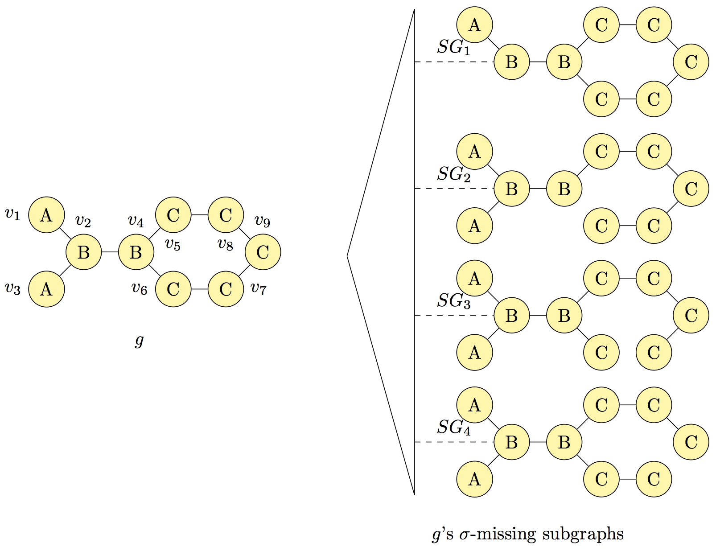
Supergraph similarity search
Shang et al. Sigmod’10
σ-missing subgraphs
Notes:
The graph g in the left side is a data graph. The right side of figure shows the framework of SG-Enum index. Assuming the threshold σ = 1, the data graph g has four subgraphs which miss exactly one edge. These subgraphs are called g’s σ-missing subgraphs(Isomorphic subgraphs are removed). The four subgraphs are shown as SG1, SG2, SG3 and SG4. In σ-missing common subgraph detection, |g| − |cs(q, g)| ≤ σ is satisfied if and only if at least one of these four subgraphs is contained by q.
The intuition that is if q contains any of these four graphs, then the distance of g with respect to q is less than delta. Then this problem can be converted to the subgraph containment search.

Slide 39
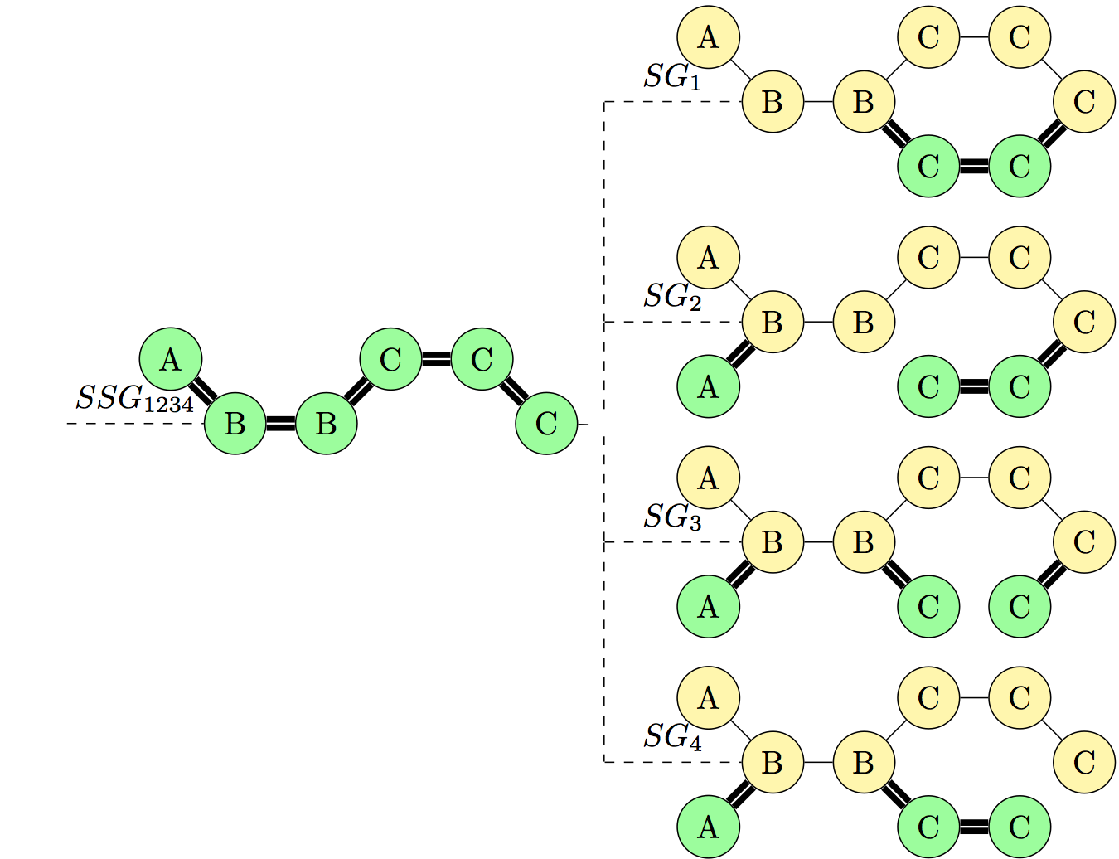
Supergraph similarity search
Shang et al. Sigmod’10
An Example of SG-Enum Index
Notes:
The σ-missing subgraphs are clustered to a tree of subgraphs. The non-leaf nodes are the maximum common subgraphs of its children, denoted as S S Gx . For example, the node S S G1234 is the maximum common subgraph of SG1, SG2, SG3, SG4.

Slide 40
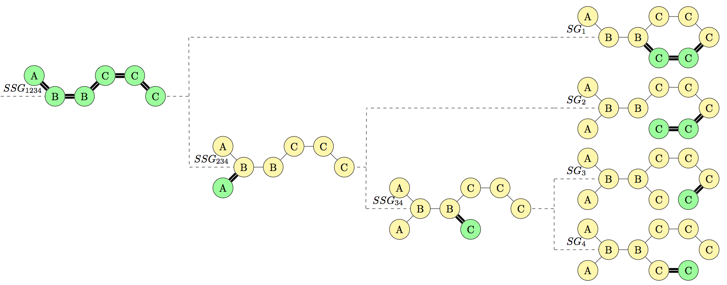
Supergraph similarity search
Shang et al. Sigmod’10
SG-Enum index constructed by top-down algorithm
Notes:
The MCS will be the root node of the global index tree. We will introduce a virtual node if no such MCS could be found. All of these subgraphs and the root node will be passed to algorithm 5 as an input. Algorithm 5 will divide these subgraphs into two groups to maximize the sharing of extension edges.

Slide 41
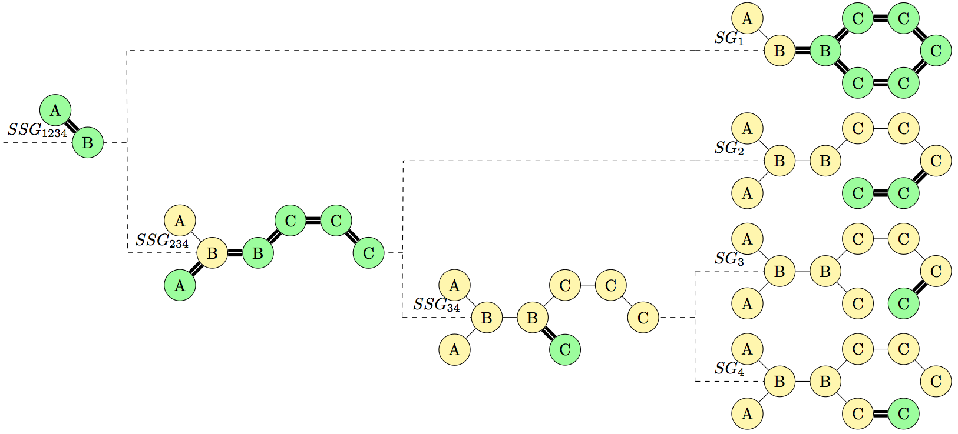
Supergraph similarity search
Shang et al. Sigmod’10
SG-Enum index constructed by bottom-up algorithm
Notes:
The bottom-up algorithm opti- mize the index by reducing the search breadth. The edges in each σ-missing subgraph are sorted to minimize the search breadth.

Slide 42

Graph similarity search
Problem definition
  Find graphs in a graph database D that are most similar to a query graph q.
C
q
B
C
B
A
C
C
Similar graphs
D
C
C
C
C
B
B
C
C
A
A
B
B
C
B
D
C
C
C
B
A
A
C
C
g₁
g₂
g₃
A
A
Notes:
Suppose we have graph database D = {g1, g2, g3}. For a query q, we want to find top-k graphs that are most similar to a this query.
So the problem we are going to solve is to find top-k graphs in a graph database D that are most similar to a query graph q.
Such a problem have a wide range of applications.
For example, finding top-k images that are most similar to a query image, or finding top-k chemical compound structures that are most similar to a query chemical compound structure.

Slide 43

Can sub/supergraph similarity search solve it?
Subgraph similarity query
  dist (q, g) = |E(q)|− |E(mcs(q, g))| (Shang et al. VLDB’08)
q
B
Cannot find the desired graph!
C
C
B
A
C
C
D
dist (q, g₁) =7−2 = 5
dist (q, g₂) = 7−5 = 2
dist (q, g₃) = 7−6 = 1
×
C
√
B
C
C
C
C
B
C
A
A
B
B
C
B
D
C
C
C
B
A
A
C
C
g₁
g₂
A
A
g₃
Notes:
If we use dist(q, g) = |E(q)| −|E(mcs(q, g))| in subgraph similarity query [15] as the distance
measure, g3 will be returned as the answer, since dist(q, g1) =
7−2 = 5, dist(q, g2) = 7−5 = 2 , and dist(q, g3) = 7−6 = 1.
Obviously, the
most similar graph to q should be g2, because they share the most
common substructures with the least difference.
This because it cannot bound the size of the database graph which can very large as long as it contains a subgraph similar to the query,

Slide 44
Can sub/supergraph similarity search solve it?
Supergraph similarity query
  dist (q, g) = |E(g)|−|E(mcs(q, g))| (Shang et al. Sigmod’10)
q
B
Cannot find the desired graph!
C
C
B
A
C
C
D
dist (q, g₁) =3−2 = 1
dist (q, g₂) = 7−5 = 2
dist (q, g₃) = 16−6 = 10
×
C
√
B
C
C
C
C
B
C
A
A
B
B
C
B
D
C
C
C
B
A
A
C
C
g₁
g₂
A
A
g₃
Notes:
If we use dist(q, g) = |E(g)|−|E(mcs(q, g))| in supergraph similarity
query [17] as the distance measure, g1 will be returned as the
answer, since dist(q, g1) = 3 − 2 = 1, dist(q, g2) = 7 − 5 = 2,
and dist(q, g3) = 16 − 6 = 10.
Obviously, the
most similar graph to q should be g2, because they share the most
common substructures with the least difference.
This because it cannot bound the size of the database graph which can very small as long as it similar to a subgraph of the query,

Slide 45
Graph similarity search
Zhu et al. EDBT’12
Find the top-k similar graphs in D for q?
Graph distance dist(q, g) = |E(q)| + |E(g)| − 2×|E(mcs(q, g))|
q
B
C
C
B
A
C
C
dist (q, g₁) =7+3−2*2 = 6
dist (q, g₂) = 7+7−2*5 = 4
dist (q, g₃) = 16+7−2*6 = 11
C
√
B
C
C
C
C
B
C
A
A
B
B
C
B
D
C
C
C
B
A
A
C
C
g₁
g₂
g₃
A
A

Slide 46
Graph similarity search
Zhu et al. EDBT’12
Compute dist (q, g) for every graph g?
How to reduce the number of of MCS computations?
  Prune unqualified graphs based on the lower bound of the graph distance, dist(q, g)
    Prune g if dist(q, g) ≥ max_{dist} , where dist(q, g) is a lower bound of dist (q, g), and max_{dist} is the largest distance of the current top-k answers discovered so far.
Expensive: MCS problem is NP-hard.

Slide 47
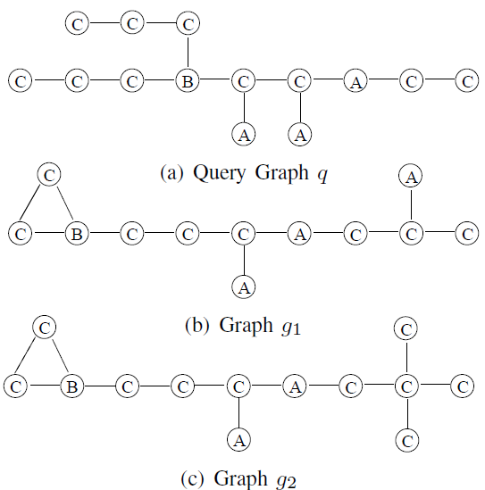

Graph similarity search
Zhu et al. EDBT’12
Edge frequency based lower bound
(A,C) (B,C) (C,C)
f (e, q) 4 3 6
f (e, g₁) 4 3 5
min 4 3 5
= 4 + 3 + 5 = 12.
dist₁(q, g₁) =13+12−2×12 = 1.
Similarly, dist₁(q, g₂)=13+13−2×12=2.
They are far away from the real graph distances, 9 and 10.

Slide 48

Graph similarity search
Zhu et al. EDBT’12
Adjacency list based lower bound
dist₂(q, g) ≥ dist₁(q, g)
w =|{B, A, C}∩{C, A, C}|= 2
dist₂(q, g₁) =13+12−2×11 = 3
> 1 = dist₁(q, g₁)
dist₂(q, g₂) = 13+13−2×12 = 2
= dist₁(q, g₂)

Slide 49
Graph similarity search
Zhu et al. EDBT’12
Observation
  dist (q, g) and dist (q, g') will be close If g and g' are similar
Triangle property of the graph distance
  dist (q, g') ≤ dist (g, g') + dist (q, g)
Third lower bound of graph distance
  dist₃(q, g ) [g' ] = dist (q, g' ) − dist (g, g' ) ≤ dist (q, g)
Fourth lower bound (relaxation of the third)
  dist₄(q, g ) [g' ] = dist (q, g' ) − dist (g, g' ) ≤ dist (q, g)
q
g'
g

Slide 50
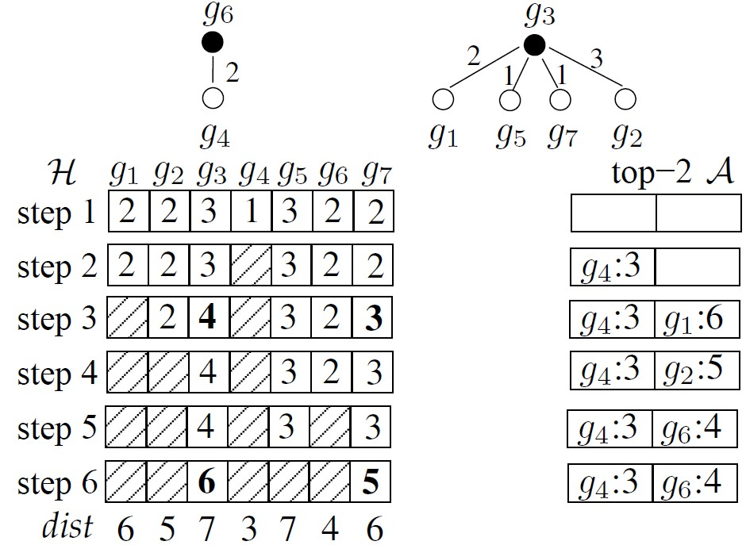


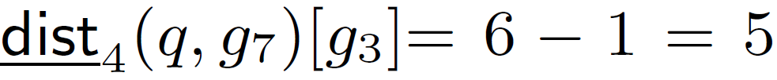
Graph similarity search
Zhu et al. EDBT’12
Lower bound by dist₁ and dist₂.
Compute dist (q, g₄ ) and push g₄ into A .
Compute dist (q, g₁ ) and push g₁ into A. Update g₃ and g₇.
Compute dist (q, g₂ ) and replace g₁ by g₂ in A.
Compute dist (q, g₆ ) and replace g₂ by g₆ in A.
Compute dist (q, g₅ ). Update g₃ and g₇.
Stop.
C₁
C₂
Totally need 5 MCS computations
Will need 7 MCS computations if we only used the first two lower bounds

Slide 51
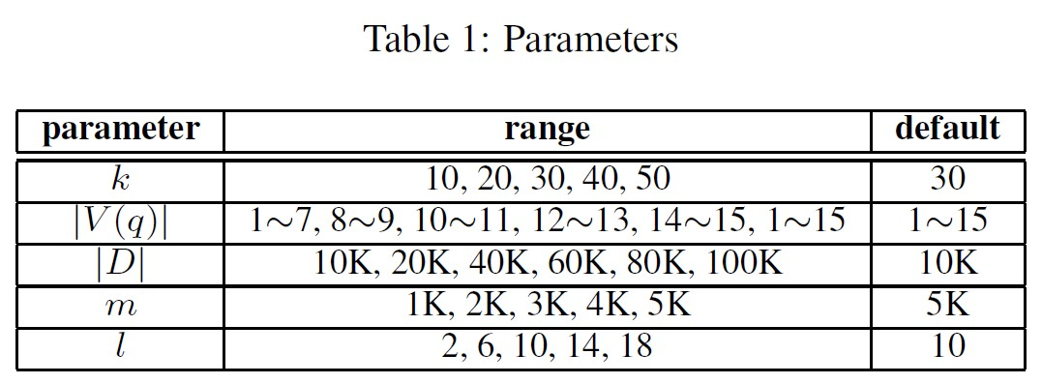
Graph similarity search
Zhu et al. EDBT’12
Dataset
  NCI dataset. We extract six datasets that consist of 10K, 20K, 40K, 60K, 80K and 100K graphs, respectively. We also randomly extract another 1,000 graphs as query set
Parameters
  We evaluate our approaches by varying five parameters.

Slide 52
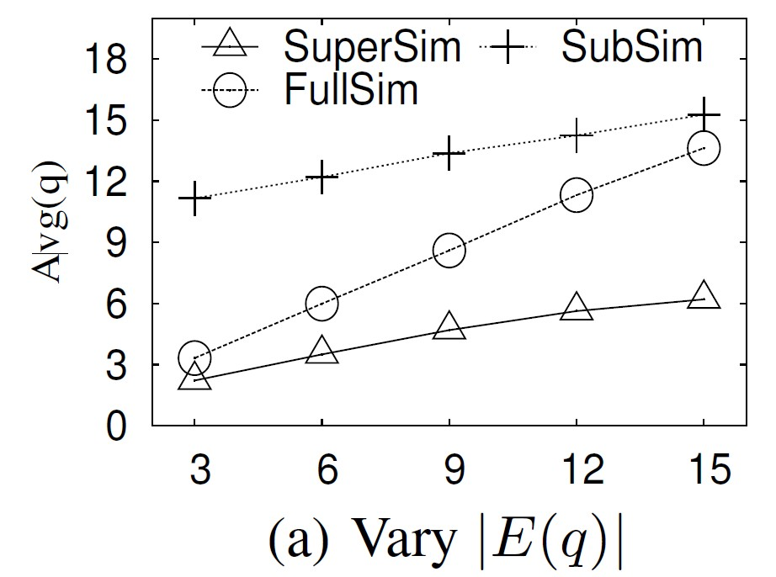
Graph similarity search
Zhu et al. EDBT’12
Similarity measures evaluation
  SubSim: Subgraph similarity dist (q, g) = |E(q)|− |E(mcs(q, g))|
  SuperSim: Supergraph similarity dist (q, g) = |E(g)|−|E(mcs(q, g))|
  FullSim: Full graph similarity in this paper, dist (q, g) = |E(q)| + |E(g)| − 2×|E(mcs(q, g))|
  Avg(q): average size of the
  top-k answer graphs for q

Slide 53
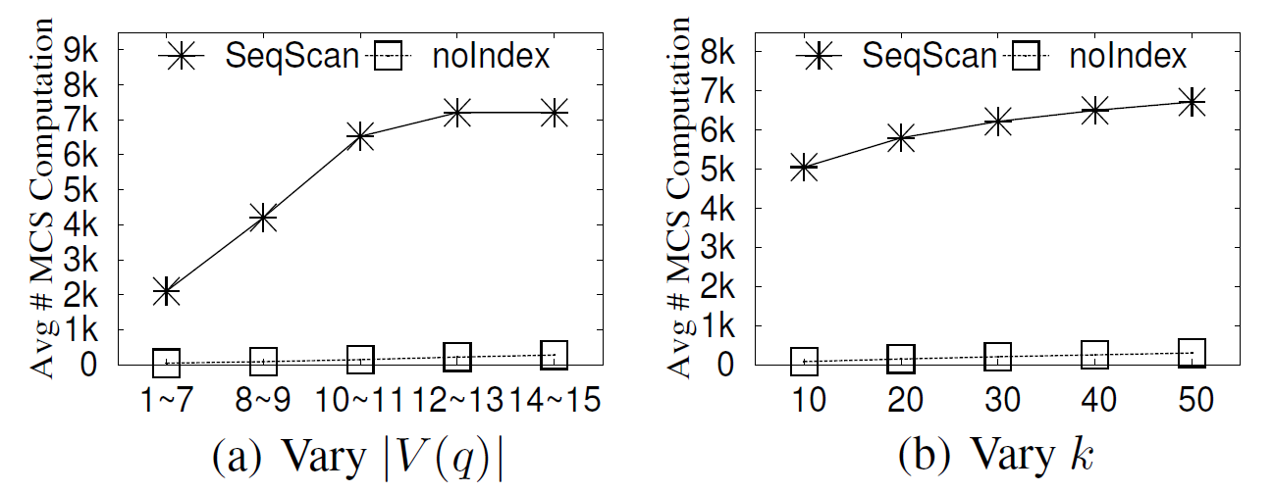
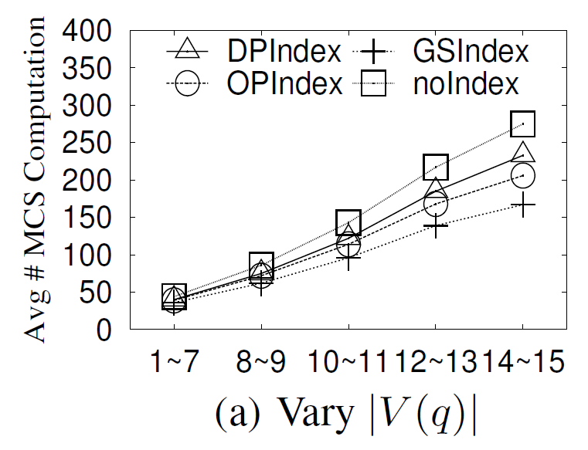
Graph similarity search
Zhu et al. EDBT’12
Power of our pruning strategy
  SeqScan: a benchmark algorithm a sequentially scan the graph database D (only compute the MCS when ||E(q)|−|E(g)|| < max_{dist})
Notes:
When the query size increases, the number of MCS
computations for noIndex and SeqScan increases. SeqScan needs
around 7000 MCS computations for graph with size larger than 10,
while noIndex needs no more than 500 MCS computations for all
testing cases, which improves the performance by about two orders
of magnitude. We vary the top-k value from 10 to 50, and report
the average number of MCS computations in Fig. 7(b). When k increases,
the average number ofMCS computations of both noIndex
and SeqScan increase. This is because when k is large, the distance
of the k-th graph in the answer set will be large, thus the filtering
condition for both noIndex and SeqScan will be hard to be satisfied
for candidate pruning. Compared with SeqScan, noIndex also
improves the performance by about two orders of magnitude.

Slide 54
Approximate graph similarity search
Zhu et al. VLDB’14
Graph query processing is challenging
  Basic graph operations are very costly, such as maximum common subgraph and graph edit distance, which are NP-hard.
Question
  Can we map a graph database onto a suitable multidimensional space to achieve high quality and efficiency online graph query?
B
A
g₁
G
H
g₃
I
A
F
A
o₂
o₁
B
C
F
?
…
o₃
C
g₂
G
I
H
C
g_{n}
o_{n}
B
A
F
A
B
E
Notes:
Despite the great expressive power of graphs, the graph query processing in real applications is very challenging, because the basic graph operations are very costly, such as maximum common subgraph and graph edit distance, which are NP-hard. Such high complexity causes a severe consequence, i.e., a lack of efficient algorithms and tools to process and analyze the graphs.
On the other hands, many operations in multidimensional spaces can be done in an efficient way. So the question is, can we Can we map graphs onto a suitable multidimensional space to achieve high quality and efficiency in online graph query processing?

Slide 55
Approximate graph similarity search
Zhu et al. VLDB’14
DS-preserved mapping
  distance-preserving: The graph dissimilarity of any two graphs in D_{G} can be approximated by the distance between its mapped two objects in the multidimensional space M_{G}.
  structure-preserving: For a given unseen query graph q, the graph dissimilarity between q and any graph in D_{G} can also be approximated by the mapped two objects in M_{G}.
g₁
g₃
…
g₂
g_{n}
…
Notes:
So, what is a good dimension should be for a graph database?
We proposed DS-preserved mapping which preserves distance and structure.
Can we identify structural dimension so that if the distance-preserving was achieved, the structure can also be preserved?

Slide 56

Approximate graph similarity search
Zhu et al. VLDB’14
Structural dimension is taken by
  Similarity is measured using the Tanimoto score which is calculated based on dictionary-based binary fingerprint.
  There are 881 substructure-keys in each fingerprint.
  Each bit in the fingerprint represents the presence (or absence) of a particular chemical substructure.
Disadvantages of identifying dimension by human being
  Need domain experts
  Time consuming and expensive, due to the large number of combinations of possible features to analyze
Notes:
In fact, using the substructure as the dimension has been taken in the PubChem Compound Database. To search similar graphs, the similarity is measured using the Tanimoto score which is calculated based on dictionary-based binary fingerprint.
There are 881 substructure-keys in each fingerprint.
Each bit in the fingerprint represents the presence (or absence) of a particular chemical substructure.
However, such structural dimensions are very difficult even for domain experts to identify, and the process of identifying such dimensions is very time consuming and expensive, due to the large number of combinations of possible features in the graph database to analyze, which can take months or even years.

Slide 57
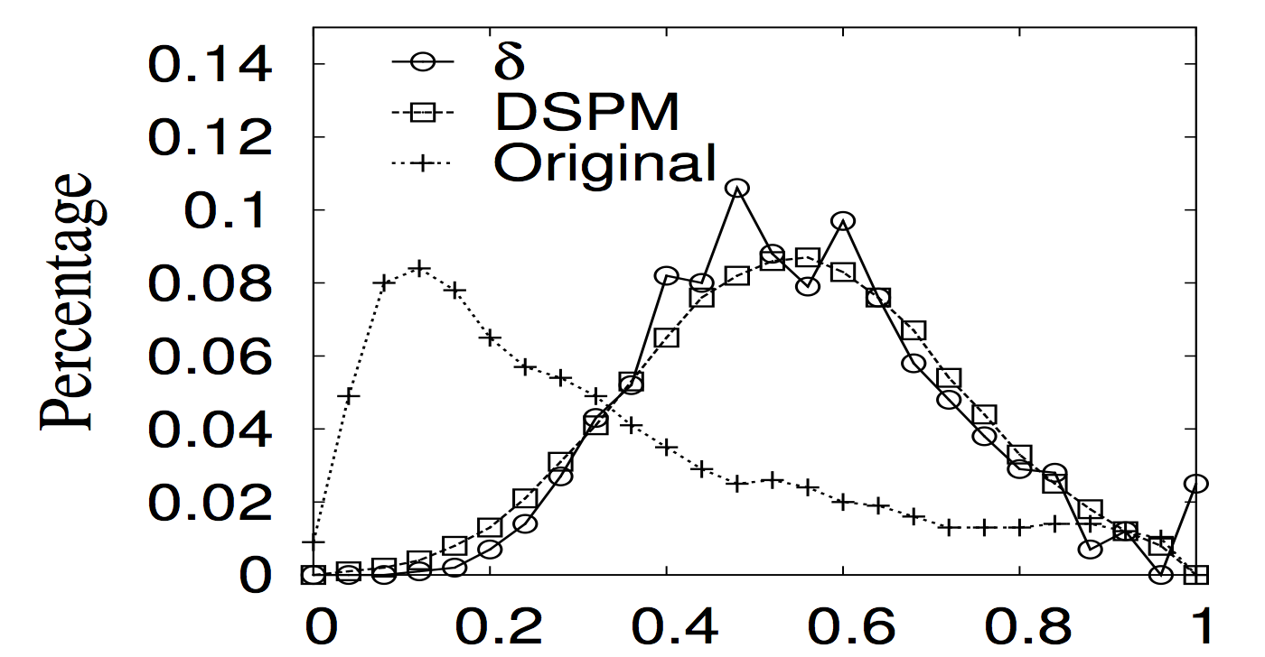
Approximate graph similarity search
Zhu et al. VLDB’14
Can we use the set of frequent subgraphs directly as the dimension?
  No.The anti-monotone property of frequent subgraphs will lead to severely unbalanced multidimensional space.
graph dissimilarity
Euclidean distance in the map space
generated by our algorithm DSPM
Euclidean distance in the map space
where all frequent subgraphs are considered as the dimensions
Notes:
Here, we use a figure to show the distance/dissimilarity distribution on real
chemical compound dataset for δ, DSPM, Original, where δ is the graph dissimilarity, DSPM represents the Euclidean distance between data objects in the map space generated by our algorithm, and Original represents the Euclidean distance in the space where all frequent subgraphs are considered as the dimensions.
The x-axis represents the value of the graph dissimilarity/distance, and the y-axis represents the percentage of the graph pairs for each dissimilarity/distance value. We can observe that Euclidean distance generated by DSPM can approximate graph dissimilarity very well while Original cannot, which shows the distance-preserving property of DSPM.

Slide 58
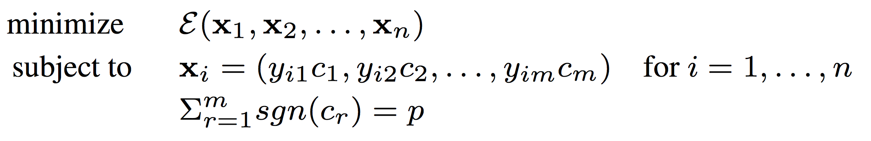

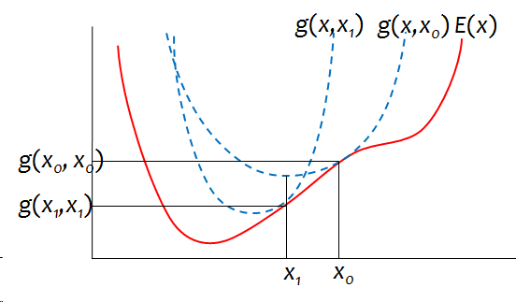
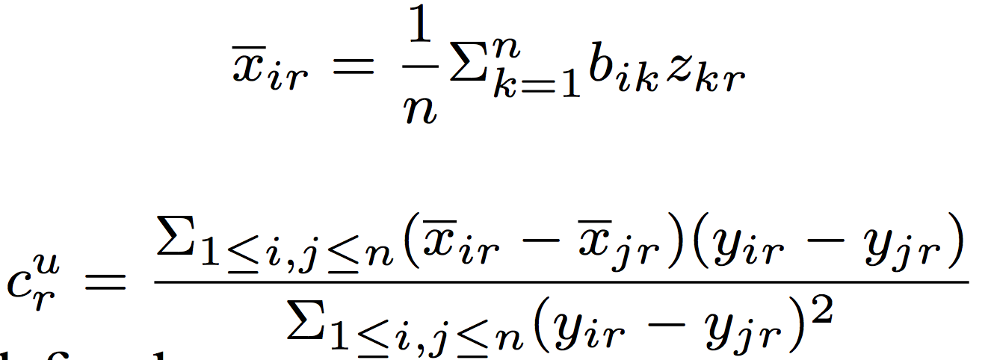
Approximate graph similarity search
Zhu et al. VLDB’14
It can be modeled as a least square optimization problem.
It can be solved by majorization strategy, which iteratively update the following configurations to achieve local minimum.

Slide 59
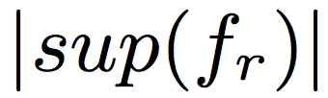
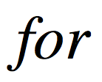
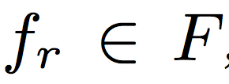
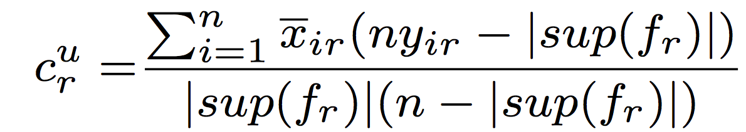
Approximate graph similarity search
Zhu et al. VLDB’14
Observations
  The bottlenecks in the majorization: computing the objective function E, configuration x and c
  A frequent subgraph does not occur in every graph.
How to utilize the characteristics of frequent subgraphs to optimize the computation?
Proposition:
The calculation of c can be simplified as
Notes:
To reduce the computational cost, we study several optimization techniques and propose a efficient new algorithm DSPM. We have two observations as follows.
The first is we find that is bottleneck parts in the majorization algorithm are computing the object function E, configuration x and c, with time complexity O(m · n²).
Meanwhile， we also have another observation that the the a frequent subgraph does not occur in every graph.
So the question is can we utilize the characteristics of frequent subgraphs to optimize the computation?
Based on the property of the frequent subgraphs, we have following proposition.
Based on this proposition ,the can simplify the update of the c by the following equation.
We propose an iterative algorithm, and discuss sev- eral optimization techniques to reduce the computational cost. We further derive an approximate algorithm to handle a large graph database.

Slide 60
Approximate graph similarity search
Zhu et al. VLDB’14
Evaluated Algorithms
  DSPM and DSPMap
  Original:take all the frequent subgraphs as the dimensions
  Sample: randomly select p frequent subgraphs
  SFS (Fukunaga et al.1990): sequential forward selection
  MICI (Mitra et al. 2002): maximum information compression index
  MCFS (Cai et al. 2010): multi-cluster feature selection
  UDFS (Yang et al. 2011):unsupervised discriminative feature selection
  NDFS (Li et al. 2012): nonnegative discriminative feature selection
Notes:
We compare our algorithms DSPM and DSPMap with the following seven algorithms
Original and Sample are two straightforward baselines where all the original frequent subgraphs and p randomly sampled frequent subgraphs are adopted as the dimensions, respectively.
SFS sequentially selects the best p features, which is one of state-of-the-art greedy feature selection algorithms.
MICI is a representative of the algorithms which select features based on feature similarity.
MCFS, UDFS, and NDFS are the up-to-date methods in unsupervised feature selection to our best knowledge.

Slide 61
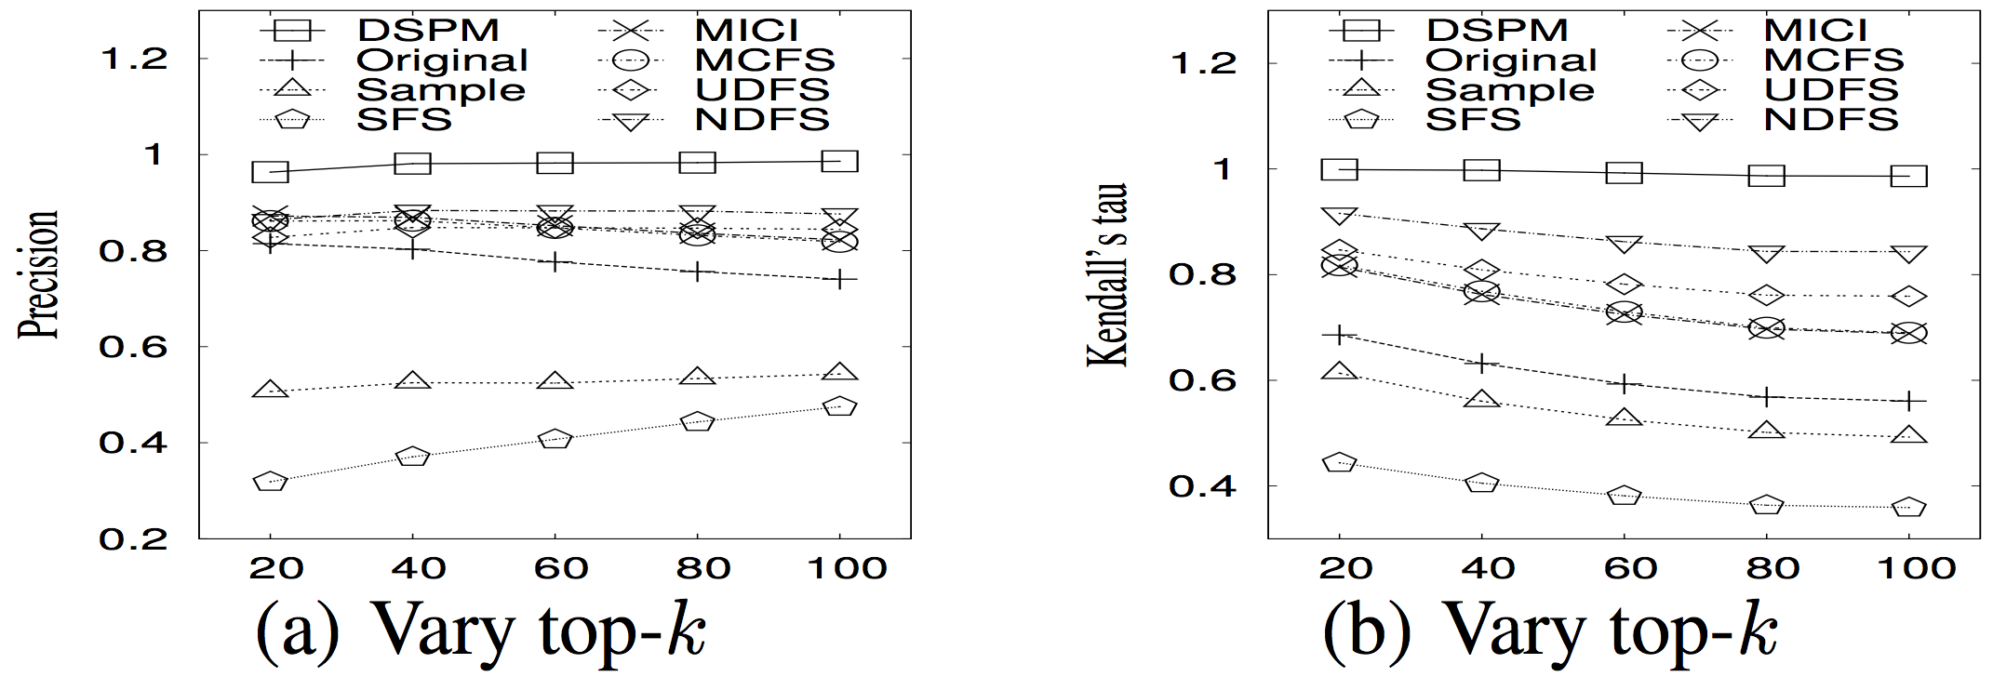

Approximate graph similarity search
Zhu et al. VLDB’14
Notes:
Here we show the performance of all the algorithm on the real dataset when we vary top-k.
In figure a, DSPM achieves the highest precision among all the algorithms and remains stable when k increases.
The precisions for DSPM, MICI, MCFS, UDFS, and NDFS are higher than that of Original.
This demonstrates that feature selection is very necessary for the frequent subgraph set to better preserve the dissimilarity and structure of graphs.
The precision of Sample is very low compared with Original, which shows that random sampling is not a good choice for selecting dimensional features in graph databases.
Fig(b) and Fig(c) shows the Kendall’s tau and rank distance, where DSPM also outperforms all the baseline methods.
In Fig(d), we report the indexing time, which is the running time of selecting. Since there is no feature selection process in Original and Sample, we only report the indexing time for DSPM, SFS, MICI, MCFS, UDFS, and NDFS. As shown in the figure, both DSPM and MICI can select the features within 10 seconds. Note that although DSPM needs more time than MCFS, it in fact has the same worst time complexity as MCFS. SFS is the most expensive method among all the algorithms, because in each step to greedily select the next best feature, it has to compute the distance for all the graph pairs to obtain the value of objective function, which is very costly.

Slide 62

Approximate graph similarity search
Zhu et al. VLDB’14
Notes:
We evaluate the scalability of the DSPMap algorithm by comparing it with other algorithms when
we vary the size of the graph database from 2k to 10k
Fig.9(a) shows the precision for all the algorithms except SFS as it cannot finish in 5 hours even for |DG| = 2k. We can see that DSPMap constantly approximates DSPM well and outperforms all the other algorithms. MICI, MCFS, UDFS, NDFS, and DSPM cannot generate the results when the size of the graph database is larger than 6k as the data cannot fit into the PC memory.
Fig(b) shows the query time for DSPMap and the exact algorithm. For clarity, we did not plot the query time for other algorithms since they are very close to DSPMap, DSPMap is 3–5 orders of magnitude faster than the exact al- gorithm.
Fig. 9(c) shows the indexing time for all the algorithms. DSPMap is the fastest and can deal with large graph databases very quickly. We did not obtain the indexing time for the rest of the al- gorithms when the graph database size is larger than 6k due to memory limit. Overall, DSPMap is 2–3 orders of magnitude faster than the other algorithms.

Slide 63
Similarity graph search (related work )
Random Walk
  Kashima et al., ICML ’03
  Gaertner et al., COLT ’03
  Mahe et al., ICML ’04
  Vishwanathan et al., NIPS ‘06
Shortest Path
  Borgwardt et. al., ICDM ’05
Cyclic Pattern Kernel
  Horvath et al., KDD ’04
Neighborhood Kernel
  Wang et. al., EDBT ’09
GED based query
  Wang et al., TKDE 2012
  Wang et al., ICDE 2012
  Zhao et al., PVLDB 2013
  Zhao et al. VLDBJ 2013

Slide 64
Extension: Approximate MCS
Zhu et al., VLDBJ’ 13, BIBM ‘17
Given two networks
and
Find a one-to-one mapping
Objective function :

Slide 65

Extension: Approximate MCS
Zhu et al., VLDBJ’ 13, BIBM ‘17
Compute Similarities
Anchor Selection and Expansion
Matching Refinement
Node similarity Measure S
  S_{seq} (u, v) sequence-based similarity score
  S_{str}(u, v) =S_{g} (u, v) × S_{l} (u, v), for node u in G1 and v in G2
  S_{g}(u, v) Global similarity in the entire graphs G1 and G2
  S_{l} (u, v) Local similarity in their neighborhoods.
Notes:
spectral method， such as Katz score [9,14] and random walk with restart (RWR) [30]. A Katz score is a weighted count of the number of walks originating (or terminating) at a given node. Un- der this random walk, the importance of a node v is the expected sum of the importance of all the nodes u that link to v.
For two nodes,u in graph G1 and v，in graph G2, they are considered highly similar if both have a high Katz/RWR score.

Slide 66
Extension: Approximate MCS
Zhu et al., VLDBJ’ 13, BIBM ‘17
Compute Similarities
Anchor Selection and Expansion
Matching Refinement
Sort all node pairs in descending order
Select seeds with constraits
Expand to align neighbor nodes
All nodes aligned. End
Notes:
spectral method， such as Katz score [9,14] and random walk with restart (RWR) [30]. A Katz score is a weighted count of the number of walks originating (or terminating) at a given node. Un- der this random walk, the importance of a node v is the expected sum of the importance of all the nodes u that link to v.
For two nodes,u in graph G1 and v，in graph G2, they are considered highly similar if both have a high Katz/RWR score.

Slide 67
Extension: Approximate MCS
Zhu et al., VLDBJ’ 13, BIBM ‘17
Compute Similarities
Anchor Selection and Expansion
Matching Refinement
u₁₄
v₁₄
u₅
u₄
v₅
v₄
u₁₁
v₁₁
u₁₀
u₃
v₁₀
u₁₂
v₁₂
u₈
u₁
u₂
v₈
v₁
u₁₆
u₁₃
u₆
u₇
v₁₆
v₁₃
v₆
v₇
u₁₅
u₉
v₁₇
v₁₅
v₉
G₁
G₂
Notes:
spectral method， such as Katz score [9,14] and random walk with restart (RWR) [30]. A Katz score is a weighted count of the number of walks originating (or terminating) at a given node. Un- der this random walk, the importance of a node v is the expected sum of the importance of all the nodes u that link to v.
For two nodes,u in graph G1 and v，in graph G2, they are considered highly similar if both have a high Katz/RWR score.

Slide 68
Extension: Approximate MCS
Zhu et al., VLDBJ’ 13, BIBM ‘17
Compute Similarities
Anchor Selection and Expansion
Matching Refienment
u₁₄
v₁₄
C = {u₆, u₈, u₁₂}
u₅
u₄
v₅
v₄
u₁₁
v₁₁
u₁₀
u₃
v₁₀
v₃
V₁−F₁
V₂−F₂
u₁₂
v₁₂
u₁₁
1
v₁₃
u₈
v₈
u₁
u₂
2
v₁
v₂
u₁₁
v₁₁
u₁₃
2
v₁₁
u₁₆
u₁₃
u₆
u₇
v₁₆
v₁₃
v₆
v₇
1
u₁₂
u₁₅
v₁₂
u₉
v₁₇
v₁₅
v₉
u₈
v₈
G₁
score(M*) > score(M)
G₂
u₆
v₁₃
v₆
u₁₃
Notes:
spectral method， such as Katz score [9,14] and random walk with restart (RWR) [30]. A Katz score is a weighted count of the number of walks originating (or terminating) at a given node. Un- der this random walk, the importance of a node v is the expected sum of the importance of all the nodes u that link to v.
For two nodes,u in graph G1 and v，in graph G2, they are considered highly similar if both have a high Katz/RWR score.

Slide 69
Extension: Approximate MCS
Zhu et al., VLDBJ’ 13, BIBM ‘17
Topological analysys
The fraction of edges matched correctly
Edge Correctness
The largest common subgraph
The size and density of the largest common subgraph
Symmetric
sub-structure
Penalize sparse and dense networks
Biological analysys
Functional consistency:FC
The fraction of shared GOterms
Average of functional similarity:AFS
The semantic similarity of the mapping
Notes:
spectral method， such as Katz score [9,14] and random walk with restart (RWR) [30]. A Katz score is a weighted count of the number of walks originating (or terminating) at a given node. Un- der this random walk, the importance of a node v is the expected sum of the importance of all the nodes u that link to v.
For two nodes,u in graph G1 and v，in graph G2, they are considered highly similar if both have a high Katz/RWR score.

Slide 70
Extension: Approximate MCS
Zhu et al., VLDBJ’ 13, BIBM ‘17
PPI network | Nodes | Edges | Average degree
RN | 1657 | 2330 | 2.812
CE | 3134 | 5428 | 3.464
MM | 4370 | 9116 | 4.172
AT | 5897 | 13381 | 4.538
SP | 1911 | 4711 | 4.930
DM | 7937 | 34753 | 8.758
HS | 13276 | 110528 | 16.651
SC | 5831 | 77149 | 26.462
Notes:
spectral method， such as Katz score [9,14] and random walk with restart (RWR) [30]. A Katz score is a weighted count of the number of walks originating (or terminating) at a given node. Un- der this random walk, the importance of a node v is the expected sum of the importance of all the nodes u that link to v.
For two nodes,u in graph G1 and v，in graph G2, they are considered highly similar if both have a high Katz/RWR score.

Slide 71




Extension: Approximate MCS
Zhu et al., VLDBJ’ 13, BIBM ‘17
GMAlign can align more edges correctly
GMAlign can find bigger and denser common subgraphs
Notes:
spectral method， such as Katz score [9,14] and random walk with restart (RWR) [30]. A Katz score is a weighted count of the number of walks originating (or terminating) at a given node. Un- der this random walk, the importance of a node v is the expected sum of the importance of all the nodes u that link to v.
For two nodes,u in graph G1 and v，in graph G2, they are considered highly similar if both have a high Katz/RWR score.

Slide 72



Extension: Approximate MCS
Zhu et al., VLDBJ’ 13, BIBM ‘17
Shared GOterms | GMAlign (%) | HubAlign (%) | GHOST (%) | NETAL (%) | MI-GRAAL (%) | L-GRAAL (%) | MAGNA (%) | SPINAL (%)
 | 8.8 | 8.56 | 8.31 | 8.08 | 7.82 | 7.66 | 7.16 | 4.20
 | 1.3 | 1.32 | 1.21 | 1.09 | 1.13 | 1.02 | 0.91 | 0.44
 | 0.18 | 0.18 | 0.21 | 0.13 | 0.18 | 0.19 | 0.08 | 0.05
 | 0.05 | 0.04 | 0.06 | 0.02 | 0.06 | 0.04 | 0.03 | 0.02
 | 0.01 | 0.02 | 0.02 | 0.01 | 0.01 | 0.01 | 0.01 | 0
GMAlign can find more protein pairs with shared GOterms
GMAlign produces a mapping with better semantic similarity
Notes:
spectral method， such as Katz score [9,14] and random walk with restart (RWR) [30]. A Katz score is a weighted count of the number of walks originating (or terminating) at a given node. Un- der this random walk, the importance of a node v is the expected sum of the importance of all the nodes u that link to v.
For two nodes,u in graph G1 and v，in graph G2, they are considered highly similar if both have a high Katz/RWR score.

Slide 73




Extension: Approximate MCS
Zhu et al., VLDBJ’ 13, BIBM ‘17
The biggest pathway, ribosome biogenesis pathway (03010), found by GMAlign
The sub-structure of ribosome biogenesis pathway (03010) found by GMAlign proved by APID
Notes:
spectral method， such as Katz score [9,14] and random walk with restart (RWR) [30]. A Katz score is a weighted count of the number of walks originating (or terminating) at a given node. Un- der this random walk, the importance of a node v is the expected sum of the importance of all the nodes u that link to v.
For two nodes,u in graph G1 and v，in graph G2, they are considered highly similar if both have a high Katz/RWR score.

Slide 74



Extension: Approximate MCS
Zhu et al., VLDBJ’ 13, BIBM ‘17
Discover conserved protein complexs
Construct evolution tree
Predict interaction relationship
Other Potential Applications

Slide 75
Outline
Introduction and preliminaries
Part I: Similarity search in graph databases
  Subraph similarity search
  Supergraph similarity search
  Graph similarity search
Part II: Community search in a single graph
  Non-attributed community search
  Attributed community search
Summary

Slide 76

Communities
Communities naturally exist in networks.
Blogosphere

Slide 77




Community Structure
  Community structure: Nodes with a shared latent property, densely inter-connected .
Many reasons for communities to be formed:
Social Networks
Citation Networks
World Wide Web
  Biological Networks

Slide 78

Community Detection
Q: Given a network, how to find all the communities?
A: Find weak ties and identify communities
  Betweenness centrality [Girvan and Newman, PNAS’02],
  Modularity [Newman, PNAS’06]
  Graph partitioning methods [Karypis and Kumar, SISC’08]
SFI collaboration network [Newman]

Slide 79

Community Search
Problem: Given a set of query nodes, find densely connected communities containing them.
query vertex

Slide 80

Community Search
5 communities containing “Jiawei Han” in DBLP collaboration network

Slide 81


Slide 82


Slide 83


Slide 84
  Non-attributed community search
In the simplest way, a graph represents a structure of interactions within a group of vertices.
Task: finding densely-connected communities containing query nodes.
  Quasi-clique model [Cui et al. SIGMOD’13]
  Query-biased densest subgraph model [Wu et al. PVLDB’15]
  K-core model [Sozio & Gionis KDD’10, Cui et al. SIGMOD’14, Li et al. PVLDB’15, Narbieri et al. DMKD’15]
  K-truss model [Huang et al. SIGMOD’14, Huang et al. PVLDB’16]

Slide 85

Quasi-Clique based Model
[Cui et al., SIGMOD’13]
  k-clique: a complete
  graph of k nodes with
  k(k−1)/2 edges.
k-cliques
(k=4)
γ-quasi-k-cliques
(γ=0.8, k=4)
α-adjacency-γ-quasi-k-cliques
(α=2, γ=0.8, k=4)

Slide 86

Quasi-Clique based Model
[Cui et al., SIGMOD’13]
  Problem: Given a query vertex q in graph, the problem is to ﬁnd all α-adjacency-γ-quasi-k-clique containing q.
?
A 0.8-quasi-7-clique containing q

Slide 87

K-Core
K-core: every vertex has degree at least k in this subgraph.

Slide 88
K-Core
K-core: every vertex has degree at least k in this subgraph.

Slide 89
K-Core based Model
[Sozio and Gionis, KDD’10]
Input:
  a graph G & a set of query nodes Q
Output: a connected subgraph H containing Q such that
  (1) Query distance D_{Q}(H) <= distance constraint.
  (2) |V(H)| <= size constraint.
  (3) H is a k-core with the largest k by satisfying (1) and (2).
Other k-core based community models:
  Local search algorithm [Cui et al. SIGMOD’14]
  Minimum-size Community [Narbieri et al. DMKD’15]
  Influential Community [Li et al. PVLDB’15]

Slide 90
K-Truss
[Jonathan Cohen, 2008]
Triangle: fundamental building blocks of networks
k-truss of graph G: every edge in H is contained in at least (k-2) triangles within H.
2-truss
p₁
p₂
s₁
s₂
p₄
3-truss
p₃
t
q
x₁
s₃
s₄
4-truss
r₁
r₂
r₃
x₂
k_{max}= 4

Slide 91
K-Core V.S. K-Truss
K-core: any pair of vertices within an edge
may have no common neighbors.
K-truss: any pair of vertices within an edge
must have k-2 common neighbors.
e
d
e
d
f
c
f
c
a
b
a
b
3-core
3-truss

Slide 92
K-truss Community Model
[Huang et al., SIGMOD’14]
A k-truss community satisfies:
  (1) K-truss: each edge within at least (k-2) triangles
  (2) Edge Connectivity: all pairs of edges connected by triangles
  (3) Maximal Subgraph
p₁
p₂
s₁
s₂
C₁
p₃
p₄
t
q
x₁
s₃
s₄
r₁
C₂
r₂
r₃
x₂
Two 4-truss communities for q

Slide 93
Index Based Query Processing Algorithm Framework
Index Construction (offline)
  They design a novel and compact tree-shaped structure called TCP-index.
Query Processing (online)
  Based on TCP-index, k-truss community search can be done in optimal time complexity.

Slide 94
TCP-Index Construction
TCP-Index for vertex x is a tree structure as T_{x}.
  T_{x} is a maximum spanning forest.
  Build T_{x} with weighted edges level by level.
  O(m) linear disk space, O(|Ans|) optimal query time.
s₂
s₁
s₂
s₁
s₂
s₁
5-truss edge
x₁
Level-5 edge
x₁
x₄
x₁
x₄
x₄
s₄
s₄
s₄
s₃
s₃
s₃
q
4-truss edge
Level-4 edge
x₃
x₂
x₃
x₂
x₃
p
x₂
p
p
3-truss edge
r₁
Level-3 edge
r₁
r₂
r₁
r₂
r₂
G_{q}
T_{q}

Slide 95

Query Processing using TCP-Index
Each edge is accessed only 2 times. Constant!!!
(First time in black; Second time in red.)
q
s₁
5
s₂
4
s₂
5
x₁
x₄
5
s₄
5
4
x₁
x₃
x₄
s₃
5
5
5
q
3
5
p
x₂
x₃
x₂
x₄
3
x₂
x₃
r₁
3
r₂
5
V₅(q, x₁) ={x_{1,} x_{2,} x_{3,} x₄}
T_{q}
T_{x1}
V₅(x_{4,} q)
V₅(x_{1,} q) ={q, x_{2,} x_{3,} x₄}
V₅(x_{3,} q)
V₅(x_{2,} q)
A complete 5-truss Community

Slide 96

Closest Truss Community Search
[Huang et al. VLDB’16]
Input:
  a graph G & a set of query nodes Q
Output: a connected subgraph H containing Q such that
  (1) H is a k-truss with the largest k
  (2) H has the smallest diameter among subgraphs satisfying (1).

Slide 97
Case Study: DBLP network
[Huang et al. VLDB’16]
(a) 9-truss
(b) Closest Truss community
Community search on DBLP network using query Q={ “Alon Y. Halevy”, “Michael J. Franklin”, “Jeffrey D. Ullman”, “Jennifer Widom” }

Slide 98



Attributed Community Search
Motivation: many real social networks contain attributes or predicates on the vertices.
  Vertices: Person (in social networks), Attributes: name, interests, and skills.
    Facebook: link relationship, user background
    Twitter: following/follower-ship, tweets
  Vertices: Protein (in PPI networks), Attributes: GO (Gene-Ontology) terms representing molecular functions, biological processes, and cellular components.

Slide 99
The Number of Related Works
Graph type | Community Detection | Community Search
Non-attributed | [1000+ papers] | [10+ papers]
Attributed | [100+ papers] | K-core-based: ACQ K-truss-based: ATC Keyword based Query

Slide 100

Motivation
Who is in Jim Gray’s community?(cui et al. sigmod’14)
  “k-core” ; nodes connected by k=4 or more edges
A community can have 10⁵ nodes!
Why are these people considered as Jim’s community?
What is the theme of this community?

Slide 101

Attributed Community Query (ACQ)
[Fang et al. PVLDB’16]
Given a graph G, a vertex q, a set S of keywords and an integer k, find the sub-graphs s.t. each G_{q} satisfies:
    Connectivity: G_{q} is connected and it contains q ;
    Structure cohesiveness: minimum degree ≥ k ;
    Keyword cohesiveness: the number of keywords in S shared other vertices in G_{q} is maximized
Research & Sports
q=Jack, k=2, S={research, sports, tour}

Slide 102

Attributed Community (AC)
In fact, Jim has 2 distinct attributed communities (AC).
{SDSS,…}
{transaction...}
Common keyword set (AC label)

Slide 103

Community Search in Attributed Graph
[Huang and Lakshmanan, PVLDB’17]
Structure + Semantics: In addition to the network structure, users may aim to search for attribute-related communities, or attributed communities.
Input: a graph G where nodes are associated with attributes
  an input query Q consisting of nodes V_{q} and attributes W_{q}
Output: a connected community H containing Q such that most community members are densely inter-connected and have similar attributes
An example of
collaboration
attributed network

Slide 104



Community Search in Attributed Graph
[Huang and Lakshmanan, PVLDB’17]
An example attributed graph G

Slide 105

[Huang and Lakshmanan, PVLDB’17]
Community Search in Attributed Graph
Case study in the PPI network
^{Q = ({q1, q2}, {w1, w2})}
q1= 854277, q2= 856100 and w1= “GO:0001009”, w2=“GO:0001041”

Slide 106
Keyword based Community Search
[Zhu et al. ICDE’18]
Given a graph G, a set S of keywords, find the minal dense truss that containing the keywords.
Note that the there is no given query nodes and the expected trussness is unknown.

Slide 107



Keyword based Community Search
[Zhu et al., ICDE’18]
Motivation
  Keyword search
  query = {James, Green}.
Community²
Closely connected
Connected tree¹
1. Kacholia et al.VLDB’05
2. Qin et al. ICDE’09
3. Kargar et al. PVLDB’11.
Clique²
Notes:
Community². and are communities with distance between a center node and each keyword node no larger than a given threshold.
are communities with distance between a center node and each keyword node no larger than a given threshold.
and are returned, since only Steiner trees of qualified -cliques are finally extracted.

Slide 108

[Zhu et al., ICDE’18]
Keyword based Community Search
Q = {a ,c}
Minimal dense truss
3-truss
4-truss
Notes:
For example, consider a query Q = {DB,ML}. H1 and H2 in Fig. 2 are 4-truss and 3-truss containing Q. Clearly, H1 is a dense truss over Q. We also have another 4-truss induced by {v1, v2, v3, v4, v5} containing Q, but it is not minimal. Thus H1 is the minimal dense truss for the query Q.

Slide 109
[Zhu et al., ICDE’18]
Keyword based Community Search
Challenge
  The node set containing all the query keywords to be included in the dense truss is unknown, which makes existing local community search methods inapplicable.
  Verifying the minimality of a truss is costly as we need to check whether it contains any subgraph with the same trussness.

Slide 110

[Zhu et al. ICDE’18]
Keyword based Community Search
Basic Bottom-up Framework
Enumerate all the combinations of keyword nodes .
Compute and sort the upper bound for each node subset .
Search dense truss for set with the largest trussness .
Repeat 3 until the upper bounds of the trussness for the rest node sets in are smaller than the current largest truss value k_{max} obtained.

Slide 111

[Zhu et al., ICDE’18]
Keyword based Community Search
Basic Top-down Framework
Compute the upper bound of keyword set k_{max}
Check the existence of k_{max}-truss containing Q. If not, decrease k_{max} until we find one.

Slide 112

[Zhu et al., ICDE’18]
Keyword based Community Search
KT-Index Structure
  Truss index: a multi-layer structure, where the information of all the connected trusses is kept. The components in each layer are sorted by their size and assigned with an unique ID.
Truss value | Component list
Notes:
. The components in each layer are sorted by their size and assigned with an unique ID.

Slide 113

[Zhu et al., ICDE’18]
Keyword based Community Search
Keyword index.
  For each keyword , store an inverted
  list to keep the node IDs containing
  this keyword. Besides, record the upper bound of its trussness and the ID of component it occurs in each layer.
 |  | Inverted list
a | 4 |  | (4, 1), (3, 1), (3, 2)
d | 4 |  | (4, 1), (3, 2)

Slide 114

[Zhu et al., ICDE’18]
Keyword based Community Search
Case study in DBpedia
query = {‘place’, ‘Jaguar’}
  Jaguar Love and The Blood Brothers are two bands
  Jaguar Love is composed of former members of The Blood Brothers.
  Cody Votolato was a member of both bands.
  The blood brothers have performed at Fabyan Windmill in Kane County of Illinois in the United States.
Notes:
dʒæɡˌwɑr

Slide 115
Summary
Part I: Similarity search in graph databases
  Subraph similarity search
  Supergraph similarity search
  Graph similarity search
Part II: Community search in a single graph
  Non-attributed community search
  Attributed community search

Slide 116
Reference part I
[1]X. Yan, P. S. Yu, and J. Han, “Graph indexing: A frequent structure- based approach,” in SIGMOD, 2004, pp. 335–346.
[2] J. Cheng, Y. Ke, W. Ng, and A. Lu, “Fg-index: towards verification- free query processing on graph databases,” in SIGMOD, 2007, pp. 857–872.
[3] P. Zhao, J. X. Yu, and P. S. Yu, “Graph indexing: Tree + delta >= graph,” in VLDB, 2007, pp. 938–949.
[4] H. Shang, Y. Zhang, X. Lin, and J. X. Yu, “Taming verification hardness: an efficient algorithm for testing subgraph isomorphis- m,” PVLDB, vol. 1, no. 1, pp. 364–375, 2008.
[5] S. Zhang, M. Hu, and J. Yang, “Treepi: A novel graph indexing method,” in ICDE, 2007, pp. 966–975.
[6] D. Shasha, J. T.-L. Wang, and R. Giugno, “Algorithmics and applications of tree and graph searching,” in PODS, 2002, pp. 39– 52.
[7] H. He and A. Singh, “Closure-tree: An index structure for graph queries,” in ICDE, 2006, pp. 38–38.
[8] L. Zou, L. Chen, J. X. Yu, and Y. Lu, “A novel spectral coding in a large graph database,” in EDBT, 2008, pp. 181–192.
[9] D. W. Williams, J. Huan, and W. Wang, “Graph database indexing using structured graph decomposition,” in ICDE, 2007, pp. 976– 985.
[10] W. Han, J. Lee, M. Pham, and J. Yu, “igraph: a framework for comparisons of disk-based graph indexing techniques,” PVLDB, vol. 3, no. 1-2, pp. 449–459, 2010.
[11] C.Chen,X.Yan,P.S.Yu,J.Han,D.-Q.Zhang,andX.Gu,“Towards graph containment search and indexing,” in VLDB, 2007, pp. 926– 937.
[12] S.Zhang,J.Li,H.Gao,andZ.Zou,“Anovelapproachforefficient supergraph query processing on graph databases,” in EDBT, 2009, pp. 204–215.
[13] J. Cheng, Y. Ke, A. W.-C. Fu, and J. X. Yu, “Fast graph query processing with a low-cost index,” The VLDB J., pp. 1–19, 2010.
[14] X. Yan, P. Yu, and J. Han, “Substructure similarity search in graph databases,” in SIGMOD, 2005, pp. 766–777.
[15] H. Shang, X. Lin, Y. Zhang, J. X. Yu, and W. Wang, “Connected substructure similarity search,” in SIGMOD, 2010, pp. 903–914.
[16] H. Shang, K. Zhu, X. Lin, Y. Zhang, and R. Ichise, “Similarity search on supergraph containment,” in ICDE, 2010, pp. 637–648.
[17] P. Willett, J. Barnard, and G. Downs, “Chemical similarity search- ing,” JCICS, vol. 38, no. 6, pp. 983–996, 1998.
[18] H. Kashima, K. Tsuda, and A. Inokuchi, “Marginalized kernels between labeled graphs,” in ICML, 2003, pp. 321–328.
[19] T. Horva ́th, T. Ga ̈rtner, and S. Wrobel, “Cyclic pattern kernels for predictive graph mining,” in KDD, 2004, pp. 158–167.
[20] X. Wang, A. M. Smalter, J. Huan, and G. H. Lushington, “G- hash: towards fast kernel-based similarity search in large graph databases,” in EDBT, 2009, pp. 472–480.

Slide 117
Reference part I(continue)
[21] X. Wang, X. Ding, A. K. H. Tung, S. Ying, and H. Jin, “An efficient graph indexing method,” in ICDE, 2012, pp. 210–221.
[22] K. Gouda and M. Hassaan, “Csi ged: An efficient approach for graph edit similarity computation,” in ICDE, 2016, pp. 265–276.
[23] G. Wang, B. Wang, X. Yang, and G. Yu, “Efficiently indexing large sparse graphs for similarity search,” TKDE, vol. 24, no. 3, pp. 440– 451, 2012.
[24] X.Zhao,C.Xiao,X.Lin,W.Wang,andY.Ishikawa,“Efficientpro- cessing of graph similarity queries with edit distance constraints,” VLDB J., vol. 22, no. 6, pp. 727–752, 2013.
[25] X. Zhao, C. Xiao, X. Lin, and W. Wang, “Efficient graph similarity joins with edit distance constraints,” in ICDE, 2012, pp. 834–845.
[26] X. Zhao, et al., “A partition-based approach to structure similarity search,” PVLDB, vol. 7, no. 3, pp. 169–180, 2013.
[27] W. Zheng, et al., “Efficient graph similarity search over large graph databases,” TKDE, vol. 27, no. 4, pp. 964–978, 2015.
[28] H. Bunke, “On a relation between graph edit distance and maxi- mum common subgraph,” Pattern Recognition Letters, vol. 18, no. 8, pp. 689–694, 1997.
[29] Y. Zhu, L. Qin, J. X. Yu, and H. Cheng, “Finding top-k similar graphs in graph databases,” in EDBT, 2012, pp. 456–467.
[30] J. Raymond, E. Gardiner, and P. Willett, “Rascal: Calculation of graph similarity using maximum common edge subgraphs,” The Computer Journal, vol. 45, no. 6, p. 631, 2002.
[31] Y. Zhu, L. Qin, J. X. Yu, Y. Ke, and X. Lin, “High efficiency and quality: large graphs matching,” VLDB J., vol. 22, no. 3, pp. 345– 368, 2013.
[32] S. Ranu, M. X. Hoang, and A. K. Singh, “Answering top-k rep- resentative queries on graph databases,” in SIGMOD, 2014, pp. 1163–1174.
[33] J. McGregor, “Backtrack search algorithms and the maximal com- mon subgraph problem,SPE, vol. 12, no. 1, pp. 23–34, 1982.
[34] W. Suters, F. Abu-Khzam, Y. Zhang, C. Symons, N. Samatova, and M. Langston, “A new approach and faster exact methods for the maximum common subgraph problem,” Computing and combinatorics, pp. 717–727, 2005.
[35] F. N. Abu-Khzam, et al., “The maximum common subgraph problem: Faster solutions via vertex cover,” in AICCSA, 2007, pp. 367–373.
[36] L. Zou, R. Huang, H. Wang, J. X. Yu, W. He, and D. Zhao, “Natural language question answering over RDF: a graph data driven approach,” in SIGMOD, 2014, pp. 313–324.
[37] M. Theobald, H. Bast, D. Majumdar, R. Schenkel, and G. Weikum, “Topx: efficient and versatile top- k query processing for semistruc- tured data,” VLDB J., vol. 17, no. 1, pp. 81–115, 2008.
[38] J. Cheng, X. Zeng, and J. X. Yu, “Top-k graph pattern matching over large graphs,” in ICDE, 2013, pp. 1033–1044.

Slide 118
Reference part II
[1] J. X. Yu, L. Qin, and L. Chang, “Keyword search in relational databases: A survey,” IEEE Data Eng. Bull., vol. 33, no. 1, pp. 67– 78, 2010.
[2] G. Bhalotia, A. Hulgeri, C. Nakhe, S. Chakrabarti, and S. Su- darshan, “Keyword searching and browsing in databases using BANKS,” in ICDE, 2002, pp. 431–440.
[3] V. Kacholia, S. Pandit, S. Chakrabarti, S. Sudarshan, R. Desai, and H. Karambelkar, “Bidirectional expansion for keyword search on graph databases,” in VLDB, 2005, pp. 505–516.
[4] H. He, H. Wang, J. Yang, and P. S. Yu, “BLINKS: ranked keyword searches on graphs,” in SIGMOD, 2007, pp. 305–316.
[5] G. Li, B. C. Ooi, J. Feng, J. Wang, and L. Zhou, “EASE: an effective 3-in-1 keyword search method for unstructured, semi-structured and structured data,” in SIGMOD, 2008, pp. 903–914.
[6] L. Qin, J. X. Yu, L. Chang, and Y. Tao, “Querying communities in relational databases,” in ICDE, 2009, pp. 724–735.
[7] M. Kargar and A. An, “Keyword search in graphs: Finding r- cliques,” PVLDB, vol. 4, no. 10, pp. 681–692, 2011.
[8] T. Lappas, K. Liu, and E. Terzi, “Finding a team of experts in social networks,” in SIGKDD, 2009, pp. 467–476.
[9] F. Zhao, X. Zhang, A. K. H. Tung, and G. Chen, “BROAD: diversified keyword search in databases,” PVLDB, vol. 4, no. 12, pp. 1355–1358, 2011.
[10] M. Kargar, A. An, and X. Yu, “Efficient duplication free and minimal keyword search in graphs,” TKDE, vol. 26, no. 7, pp. 1657–1669, 2014.
[11] Y.Wu et al.,“Summarizing answer graphs induced by keyword queries,” PVLDB, vol. 6, no. 14, pp. 1774–1785, 2013.
[12] W. Cui, Y. Xiao, H. Wang, and W. Wang, “Local search of communities in large graphs,” in SIGMOD, 2014, pp. 991–1002.
[13] M. Sozio and A. Gionis, “The community-search problem and how to plan a successful cocktail party,” in SIGKDD, 2010, pp. 939–948.
[14] R. Li, L. Qin, J. X. Yu, and R. Mao, “Influential community search in large networks,” PVLDB, vol. 8, no. 5, pp. 509–520, 2015.
[15] N. Barbieri, F. Bonchi, E. Galimberti, and F. Gullo, “Efficient and effective community search,” DMKD, vol. 29, no. 5, pp. 1406–1433, 2015.
[16] Y.Fang, R.Cheng, S.Luo,and J.Hu,“Effective community search for large attributed graphs,” PVLDB, vol. 9, no. 12, pp. 1233–1244, 2016.
[17] X. Huang, H. Cheng, L. Qin, W. Tian, and J. X. Yu, “Querying k-truss community in large and dynamic graphs,” in SIGMOD, 2014, pp. 1311–1322.
[18] X.Huang et al. ,“Approxi mate closest community search in networks,” PVLDB, vol. 9, no. 4, pp. 276–287, 2015.
[19] E. Akbas and P. Zhao, “Truss-based community search: a truss- equivalence based indexing approach,” PVLDB, vol. 10, no. 11, pp. 1298–1309, 2017.

Slide 119
Reference part II(continue)
[20] L. Chang, X. Lin, L. Qin, J. X. Yu, and W. Zhang, “Index- based optimal algorithms for computing steiner components with maximum connectivity,” in SIGMOD, 2015, pp. 459–474. [21] J. Hu, X. Wu, R. Cheng, S. Luo, and Y. Fang, “Querying mini- mal steiner maximum-connected subgraphs in large graphs,” in CIKM, 2016, pp. 1241–1250.
[22] J. Cohen, “Trusses: Cohesive subgraphs for social network anal- ysis,” National Security Agency Technical Report, vol. 16, 2008.
[23] J. Wang and J. Cheng, “Truss decomposition in massive networks,” PVLDB, vol. 5, no. 9, pp. 812–823, 2012.
[24] Y. Zhang and S. Parthasarathy, “Extracting analyzing and visualizing triangle k-core motifs within networks,” in ICDE, 2012, pp.
1049–1060.
[25] A.E.Sariyu ̈ceandA.Pinar,“Fast hierarchy construction for dense subgraphs,” PVLDB, vol. 10, no. 3, pp. 97–108, 2016.
[26] X.HuangandL.V.S.Lakshmanan,“Attribute-driven community search,” PVLDB, vol. 10, no. 9, pp. 949–960, 2017.
[27] K. Mehlhorn, “A faster approximation algorithm for the steiner problem in graphs,” Inf. Process. Lett., vol. 27, no. 3, pp. 125–128, 1988.
[28] N. Chiba and T. Nishizeki, “Arboricity and subgraph listing algorithms,” SIAM J. Comput., vol. 14, no. 1, pp. 210–223, 1985.
[29] B. Ding, J. X. Yu, S. Wang, L. Qin, X. Zhang, and X. Lin, “Finding top-k min-cost connected trees in databases,” in ICDE, 2007, pp. 836–845.
[30] K. Golenberg, B. Kimelfeld, and Y. Sagiv, “Keyword proximity search in complex data graphs,” in SIGMOD, 2008, pp. 927–940.
[31] G. Kasneci, M. Ramanath, M. Sozio, F. M. Suchanek, and G. Weikum, “STAR: steiner-tree approximation in relationship graphs,” in ICDE, 2009, pp. 868–879.
[32] R. Li, L. Qin, J. X. Yu, and R. Mao, “Efficient and progressive group steiner tree search,” in SIGMOD, 2016, pp. 91–106.
[33] M. Xie, S. S. Bhowmick, G. Cong, and Q. Wang, “PANDA: toward partial topology-based search on large networks in a single machine,” VLDB J., vol. 26, no. 2, pp. 203–228, 2017. [Online]. Available: https://doi.org/10.1007/s00778-016-0447-0
[34] S.Yang,Y.Wu,H.Sun,andX.Yan,“Schemaless and structureless graph querying,” PVLDB, vol. 7, no. 7, pp. 565–576, 2014. [Online].
Available: http://www.vldb.org/pvldb/vol7/p565-yang.pdf

Slide 120

120
Thank you!
Questions？

